Slide 1









WiNeRF: Measurement Constrained Radiance Fields for Actionable Wireless Channel Modeling
Saif
Ur Rahman¹
Rafid Umayer
Murshed¹
Anton
Dmitriev¹
Cagri
Tanriover²
Rahul C.
Shah²
Elahé
Soltanaghai¹
¹ University of Illinois Urbana-Champaign ² Intel
EWSN 2026

Slide 2
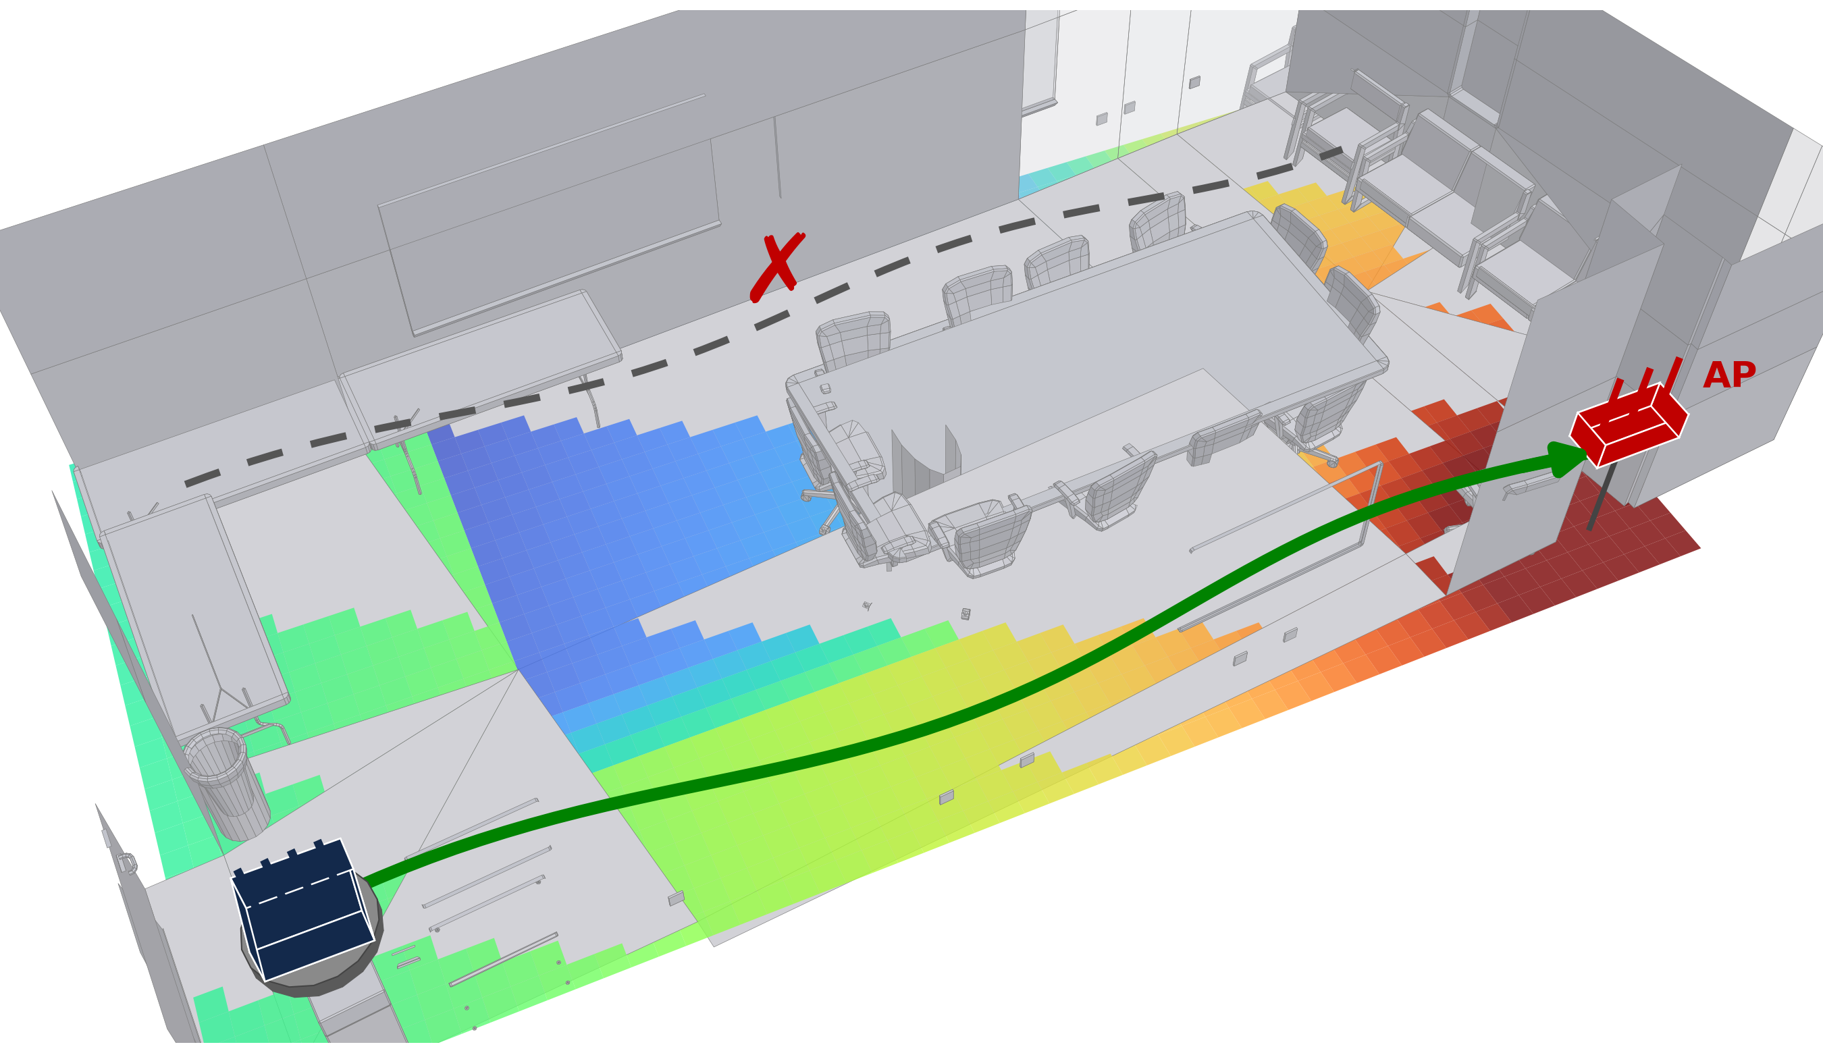
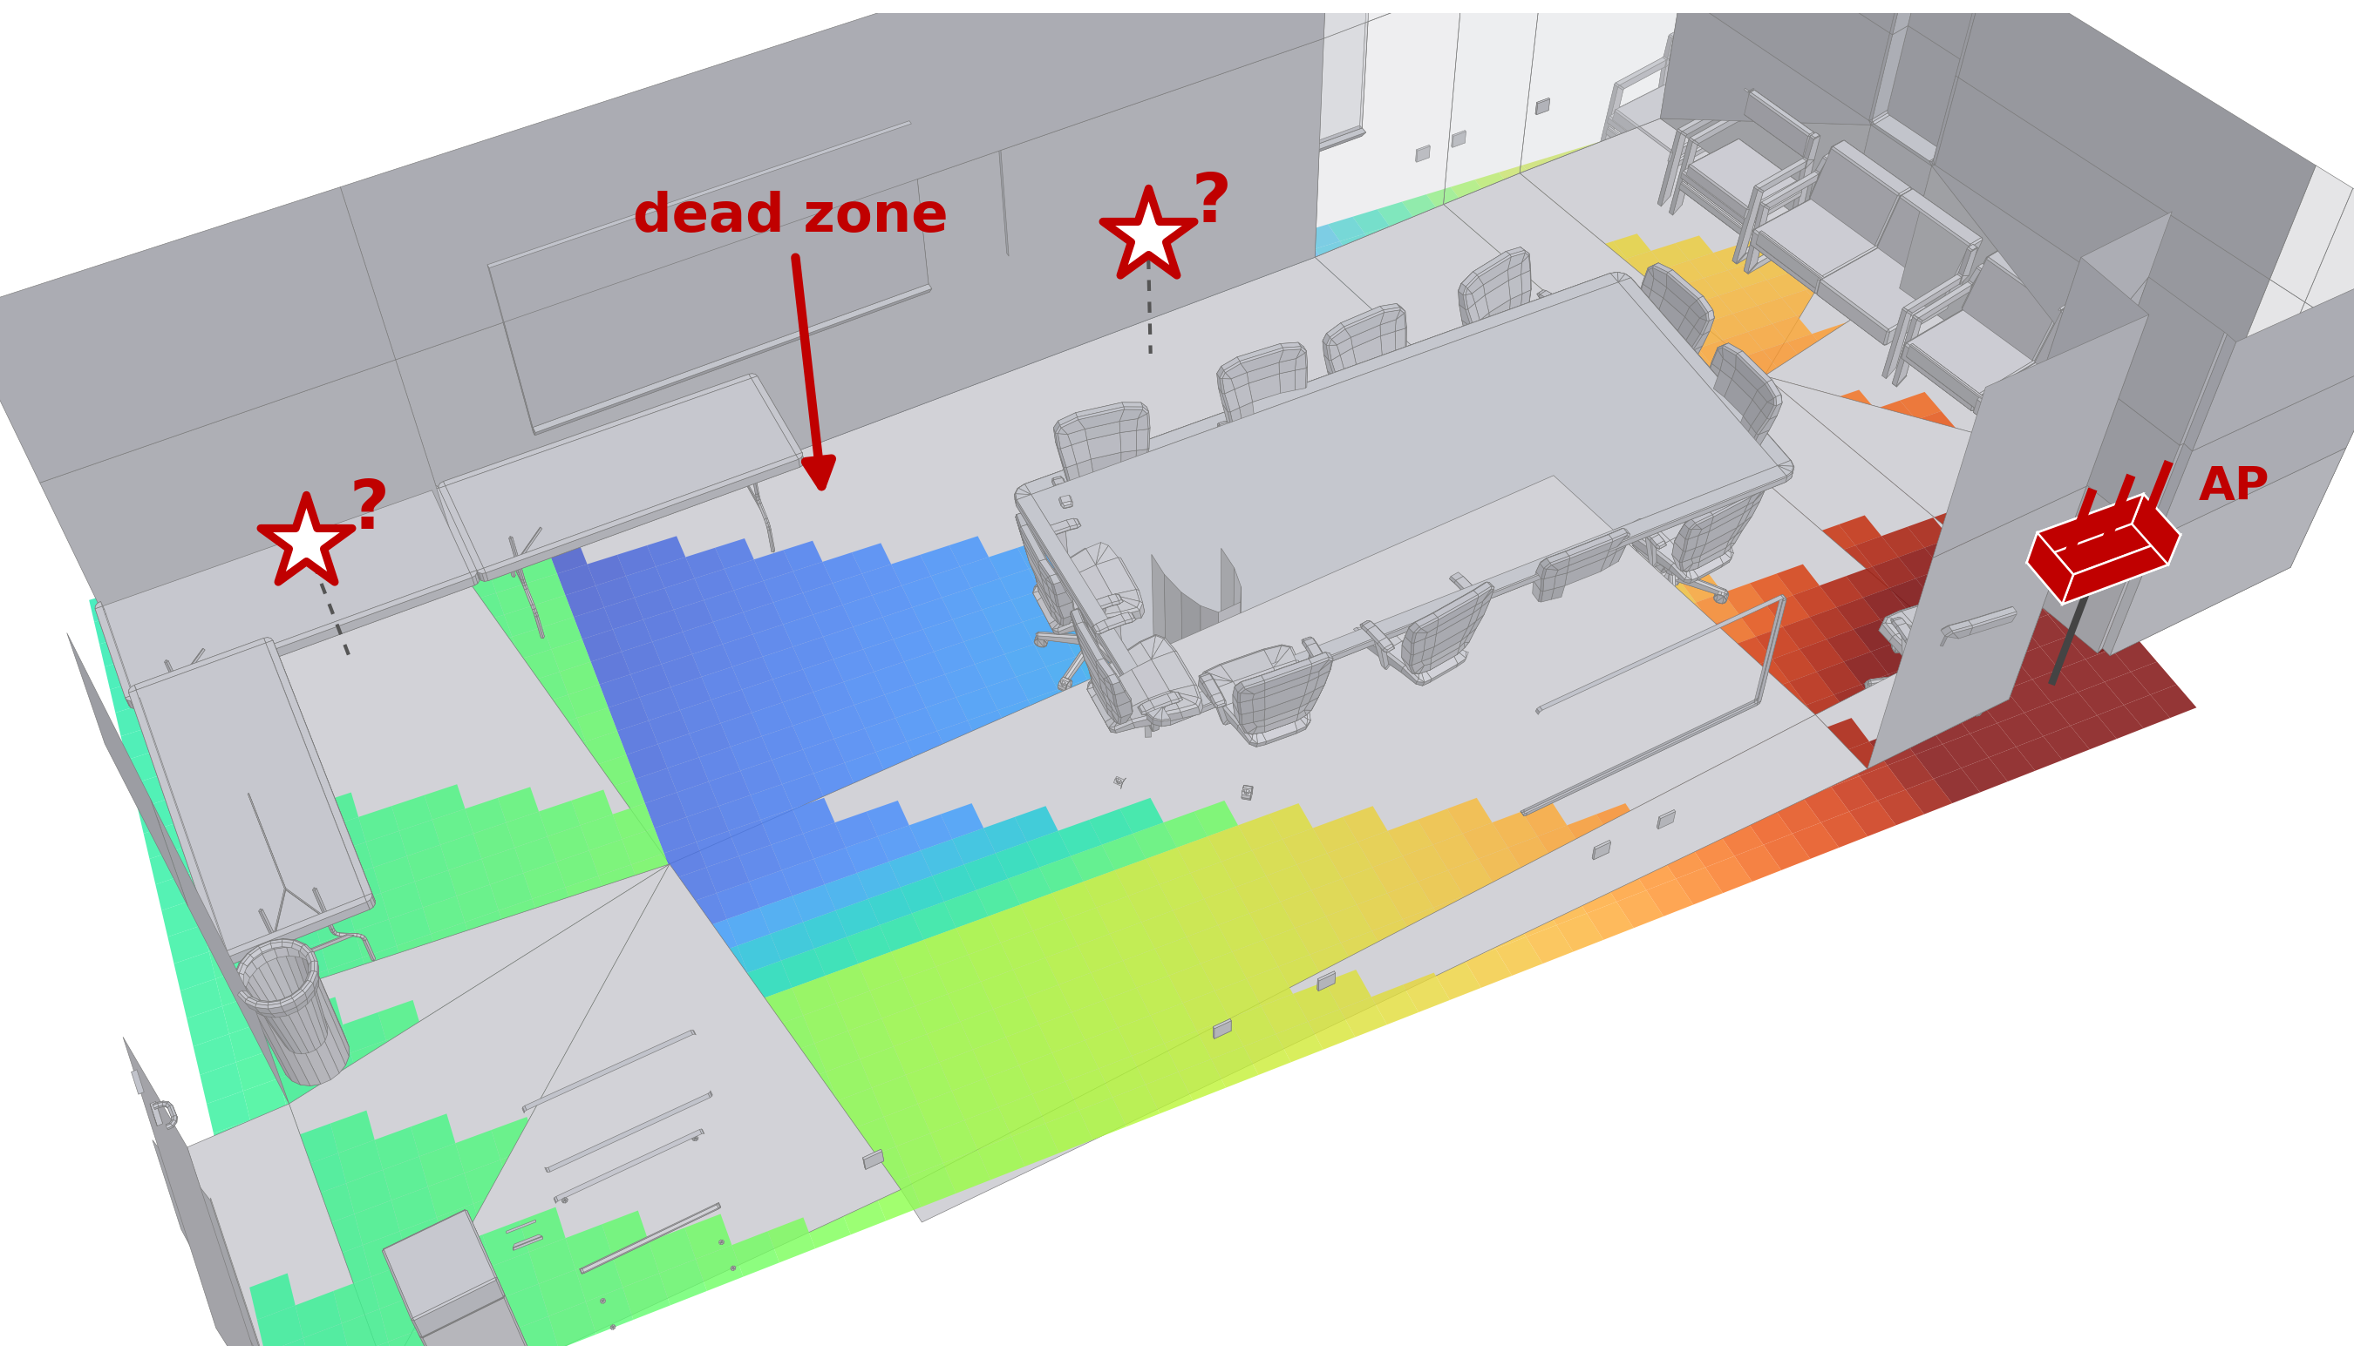
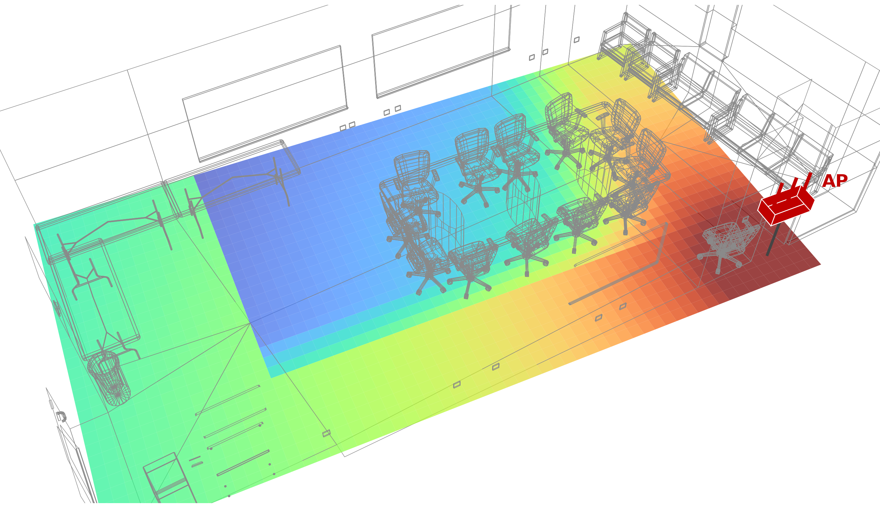
Why knowing the channel everywhere matters
Connectivity-aware robots
Coverage and AP planning
Wireless digital twins
All three need the channel at unseen locations
none of them gets it from a device’s own sparse measurements
plan the path through good coverage
choose the AP position with no dead zone
predict the channel inside a 3D model
needs: link quality at locations it has not visited
today: statistical path-loss models [1]
needs: coverage at every point before deploying
today: interpolated site-survey RSSI [2]
needs: the channel at every point of the model
today: ray tracing from a CAD model [3]

Slide 3
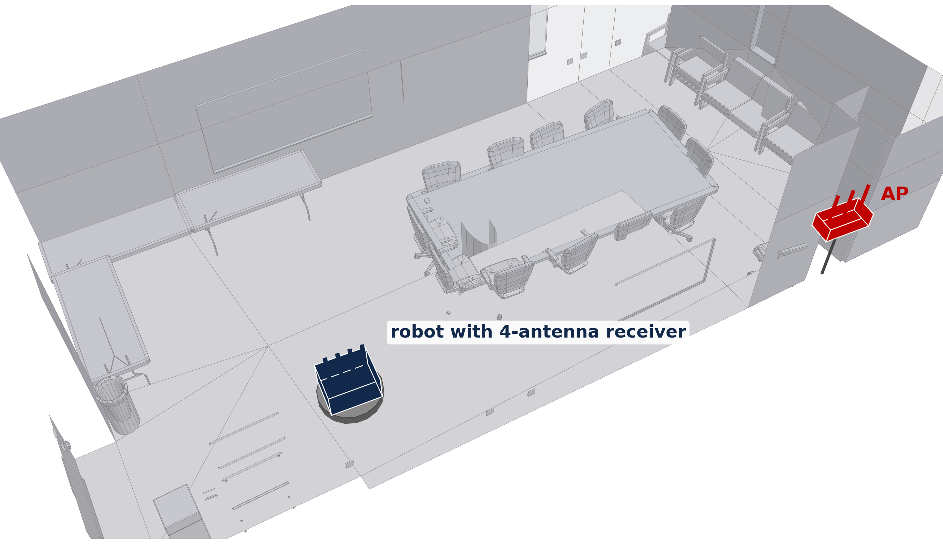
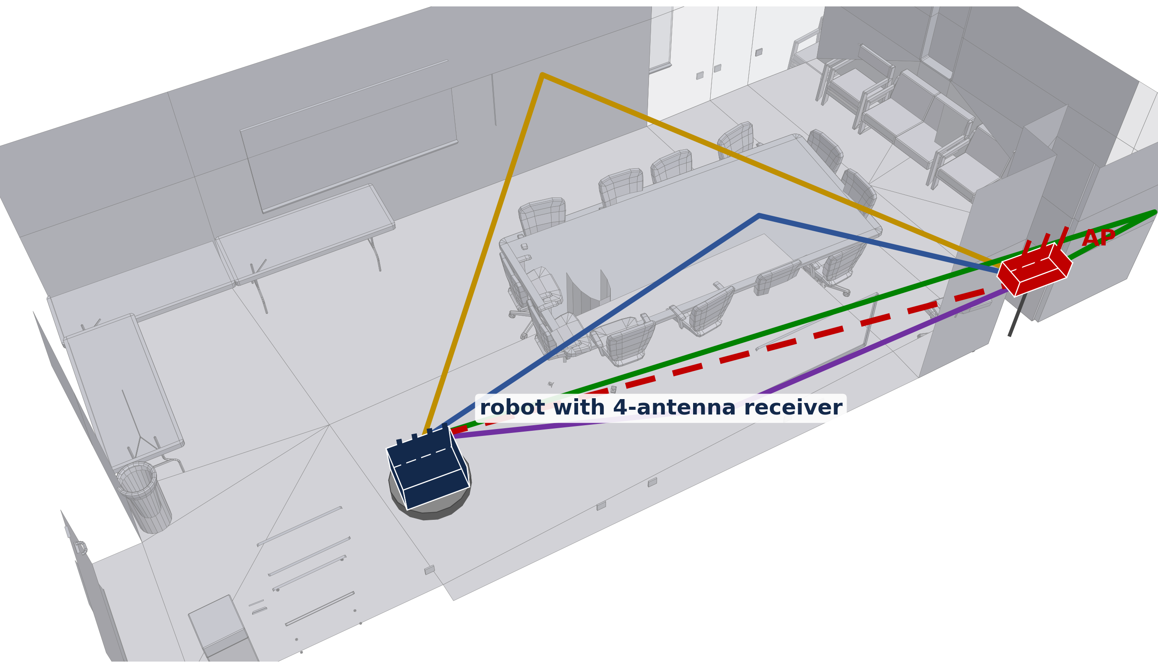
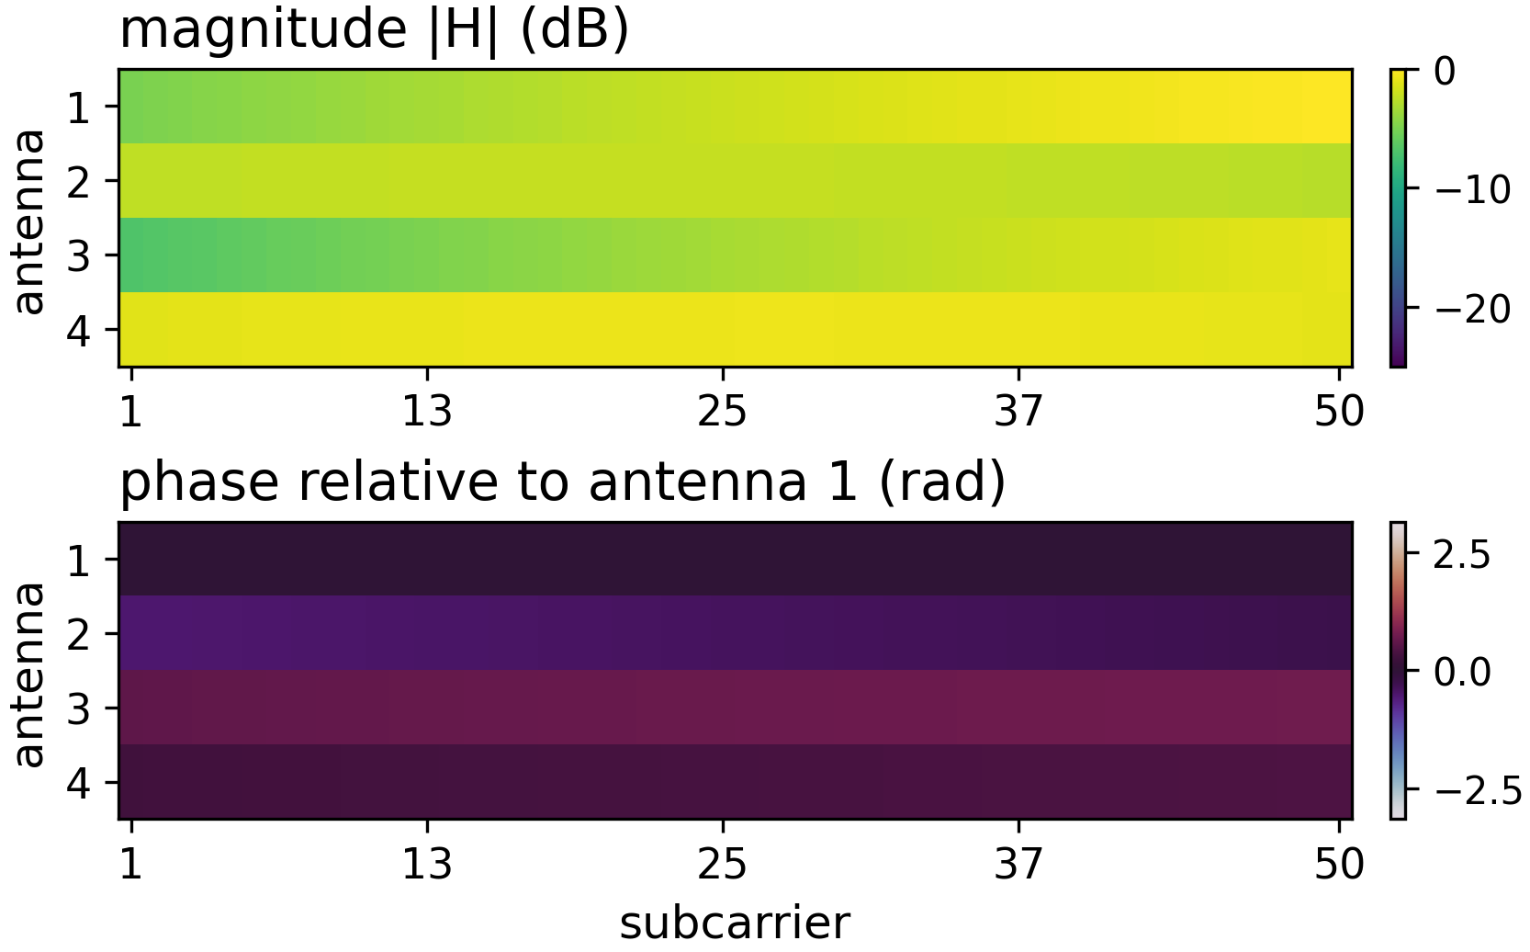
What the receiver measures: the CSI matrix
OFDM
decoding
CSI (H): 4 antennas × 50 subcarriers
one measurement, at the receiver’s own position
Wireless multipath: direct, walls, ceiling, floor, furniture
OFDM decoding: one complex gain per antenna per subcarrier
CSI (H) is the sum of all paths
H = ▬ + ▬ + ▬ + ▬ + ▬

Slide 4
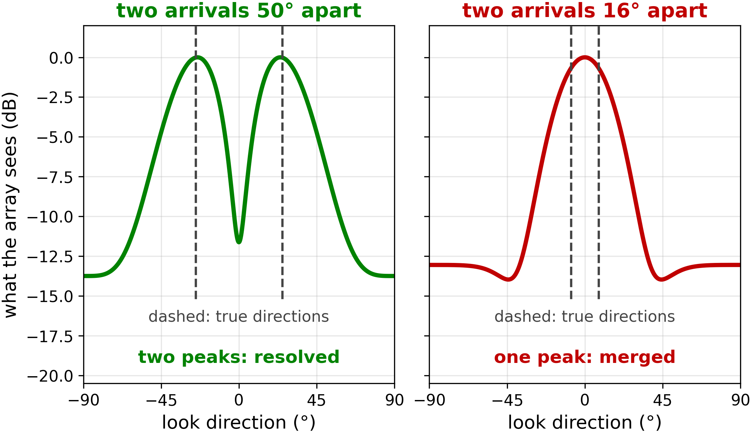
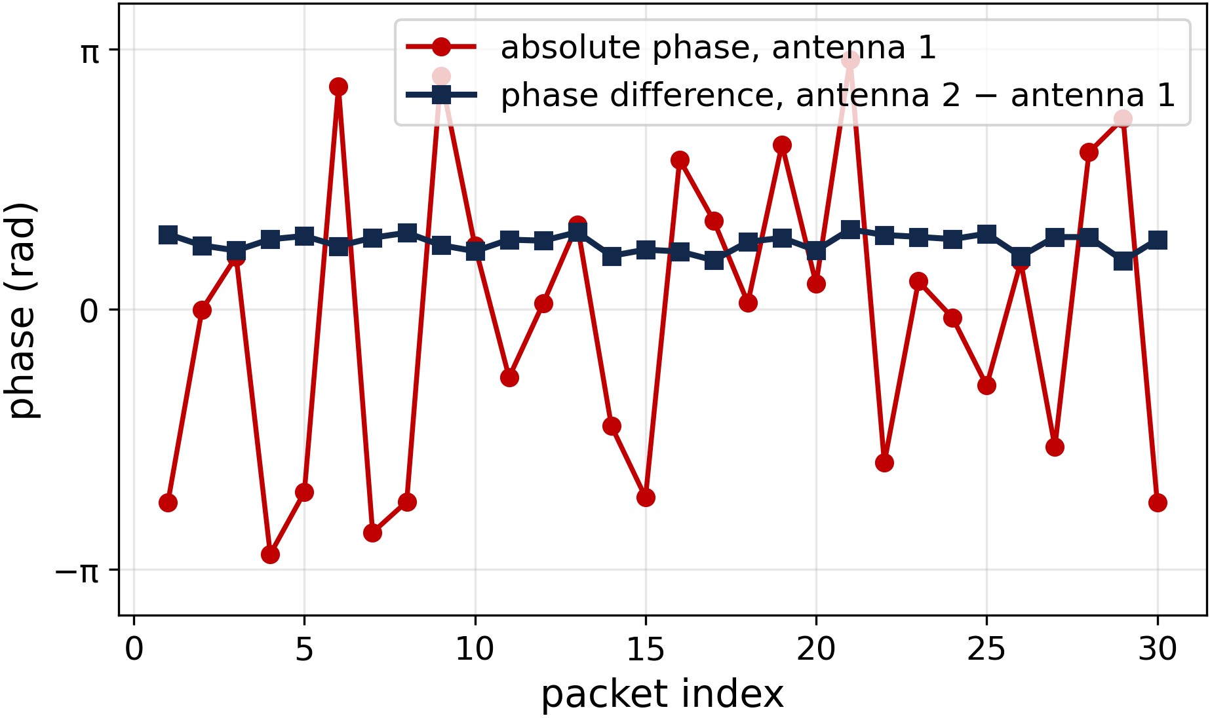
CSI measurement is coarse: two hardware limits
Angle: 4 antennas cannot separate nearby arrivals
Phase: the absolute phase reference is unstable
array output vs. look direction; dashed: true angle of arrivals (AoA)
absolute phase jumps every packet; the difference stays put
limit: antenna array configuration puts limit on AoA resolution
limit: absolute phase is unusable
WiNeRF: samples the rays the way the hardware sees them, as sets of directions it cannot tell apart
WiNeRF: learns and is scored on relative phase only
left: array factor of a 4-element λ/2 linear array [8]; right: toy illustration

Slide 5
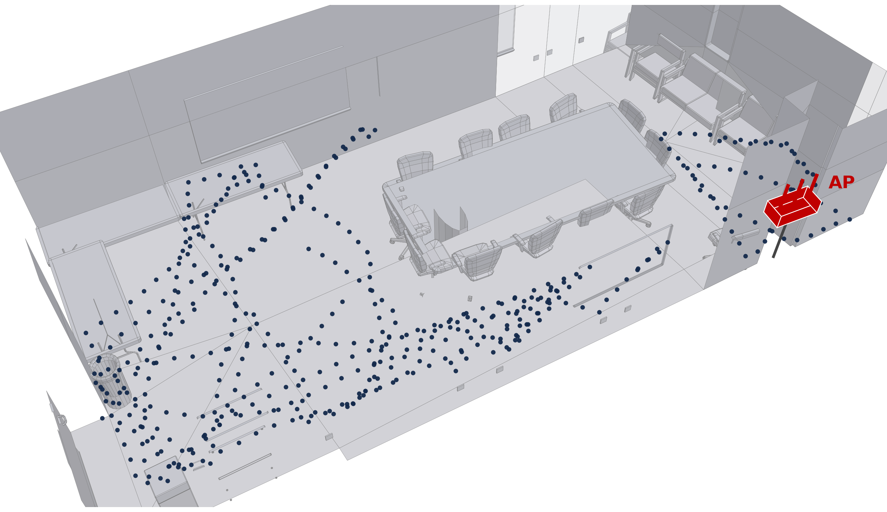

The problem: predicting the channel at unseen locations
Have
a few hundred coarse channel snapshots along a trajectory
an unseen location
what is the channel here?
Want
the channel at every unseen location
Underconstrained
many different arrangements of walls and furniture would produce the same few snapshots

Slide 6
Prior neural wireless fields trade extra information for output fidelity
Can the measurement limits themselves guide the radiance field training?
WiNeRF
needs: nothing
gives: complex CSI
NeWRF [7]
needs: arrival angles
gives: complex CSI
WiNeRT [5]
needs: 3D model, per-path labels
gives: impulse response
Output fidelity (RSSI → complex CSI)
NeRF² [4]
needs: thousands of positions
gives: RSSI, spatial spectrum
complex CSI at unseen locations, from the device’s own sparse, real measurements
RFCanvas [6]
needs: camera images
gives: RSSI
External information required (beyond the device’s own CSI)
evaluated on real measurements
synthetic only

Slide 7
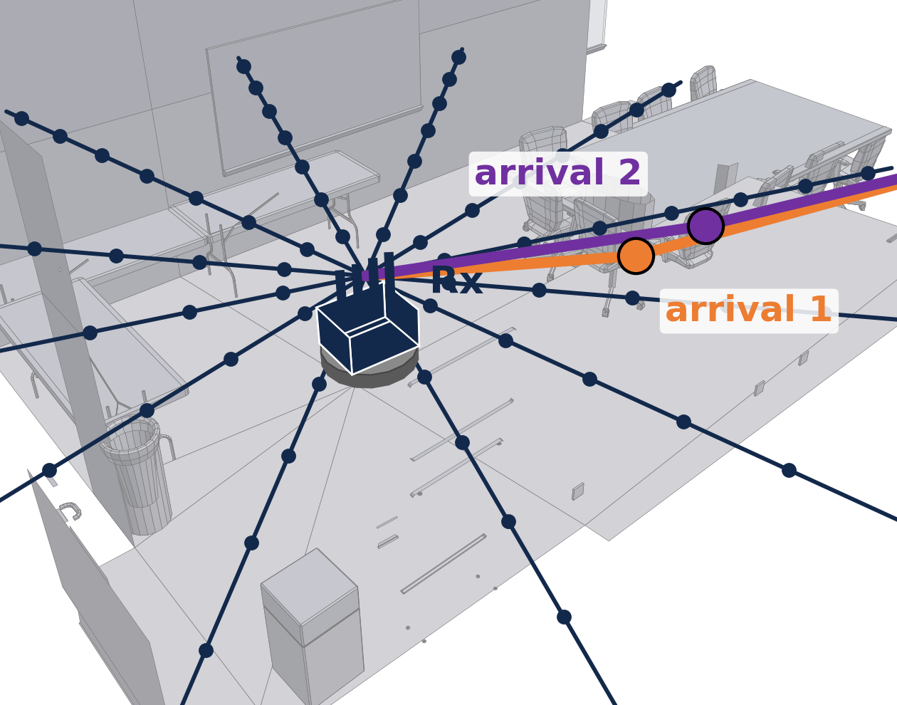
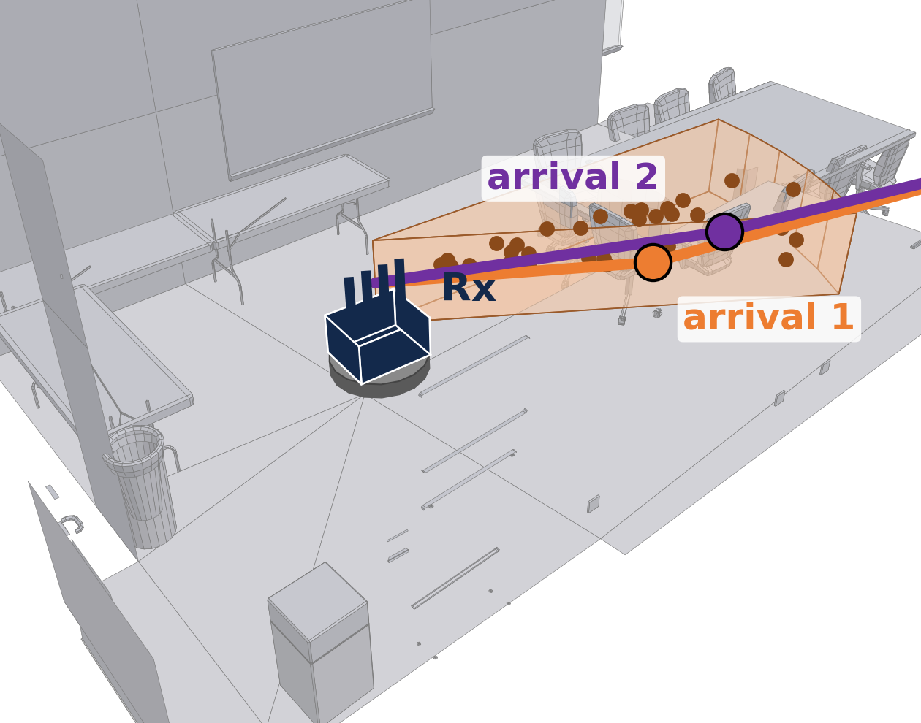
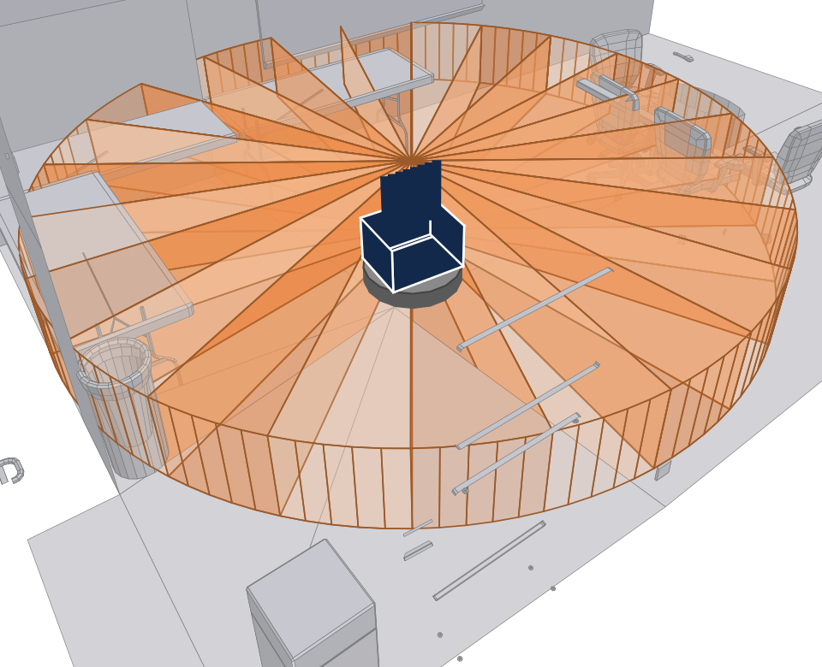
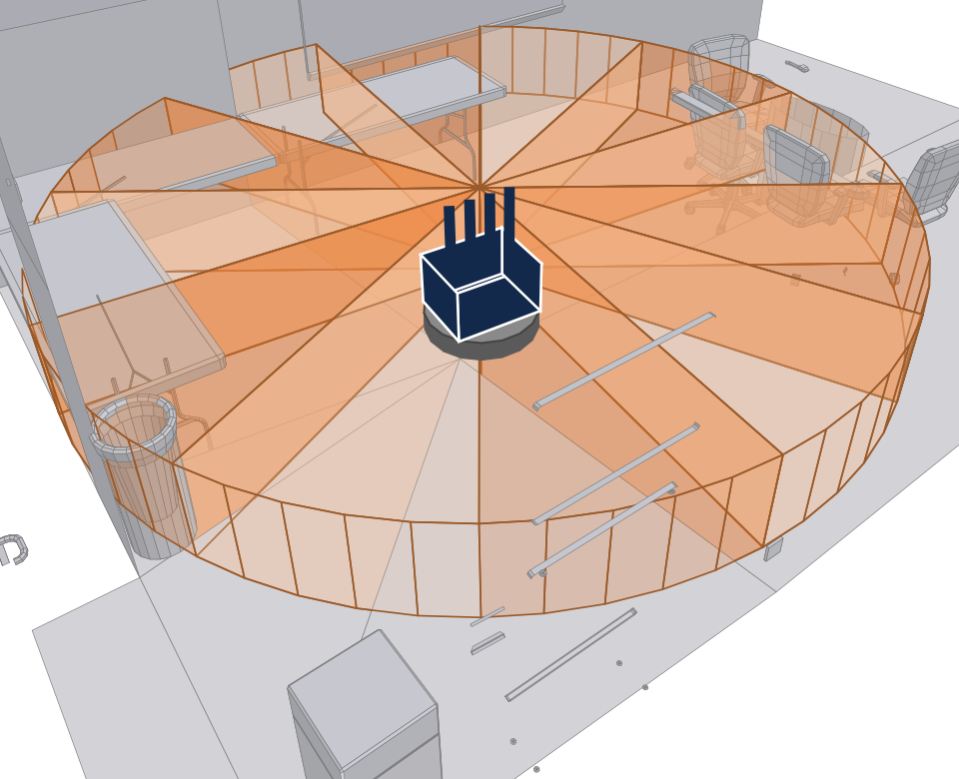
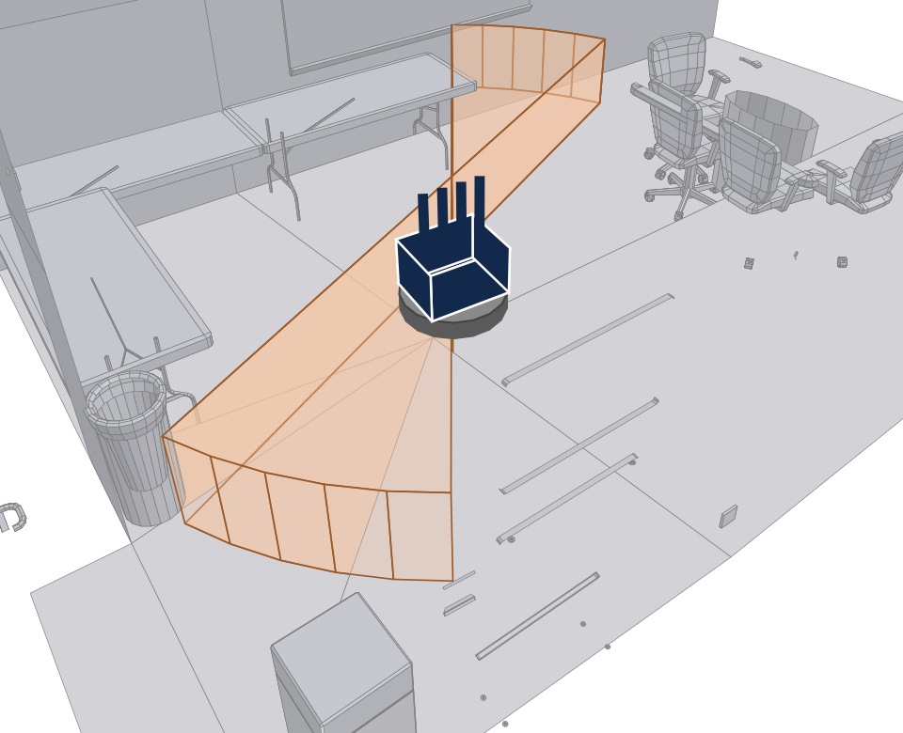
Why cones? Sample only what the array can actually resolve
thin rays (NeRF², NeWRF)
cone (WiNeRF)
two arrivals inside one sector look identical to the antenna array
thin rays sample them as distinct directions: aliasing
a cone integrates the sector; it is not a beam pattern
samples a set of directions as if the array could tell them apart
one sample volume for the whole sector the array resolves
(a) more antennas:
narrower cones
(b) fewer antennas:
wider cones
(c) linear array:
front and back mirrored
cone width and shape follow the antenna array

Slide 8
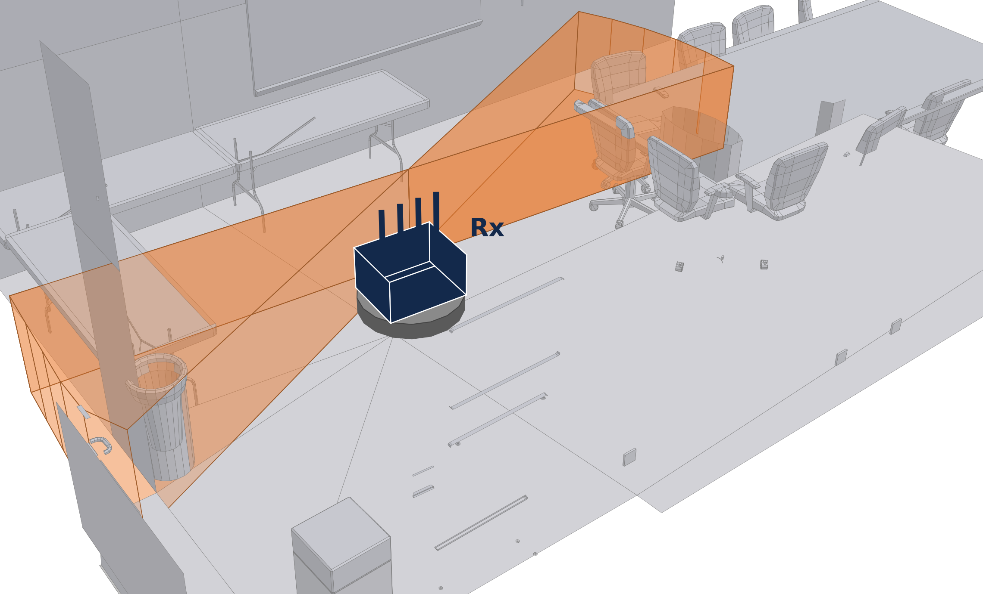
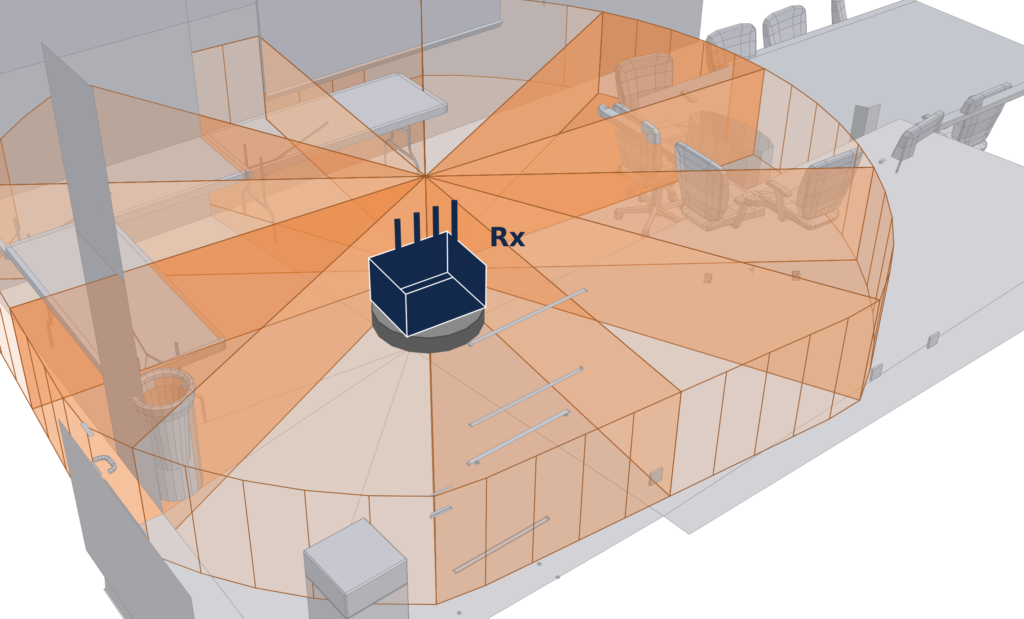
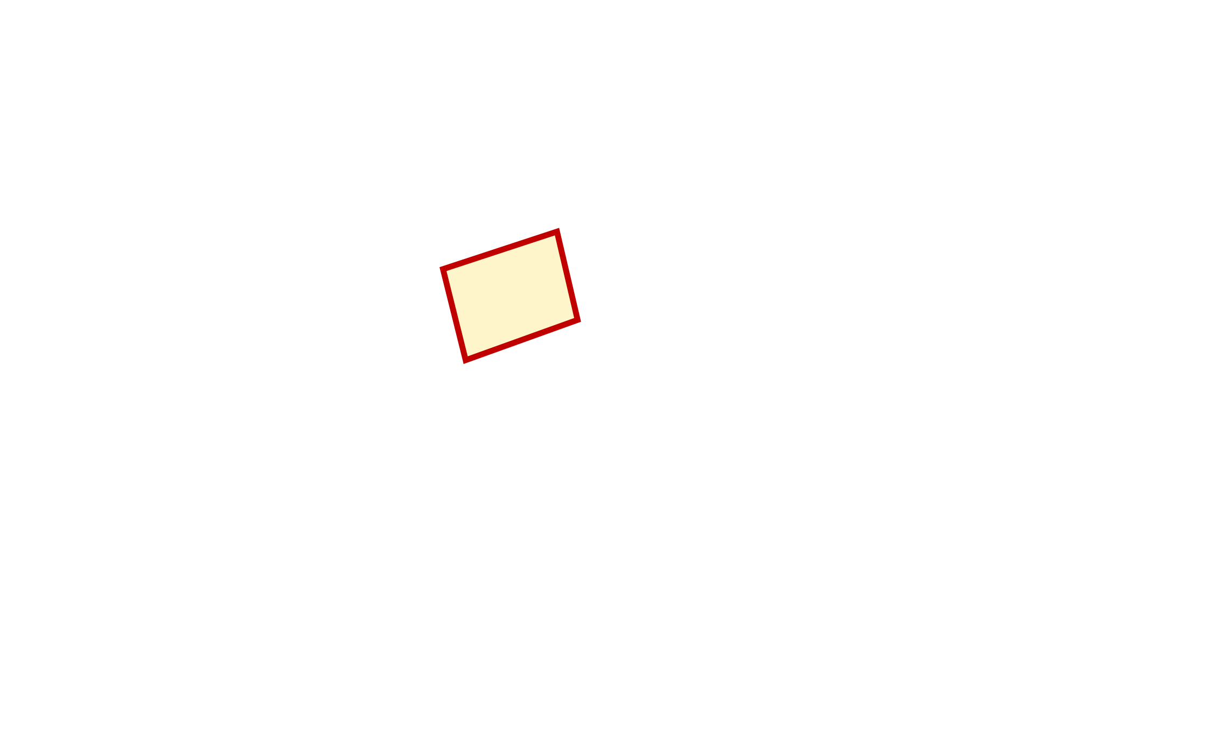
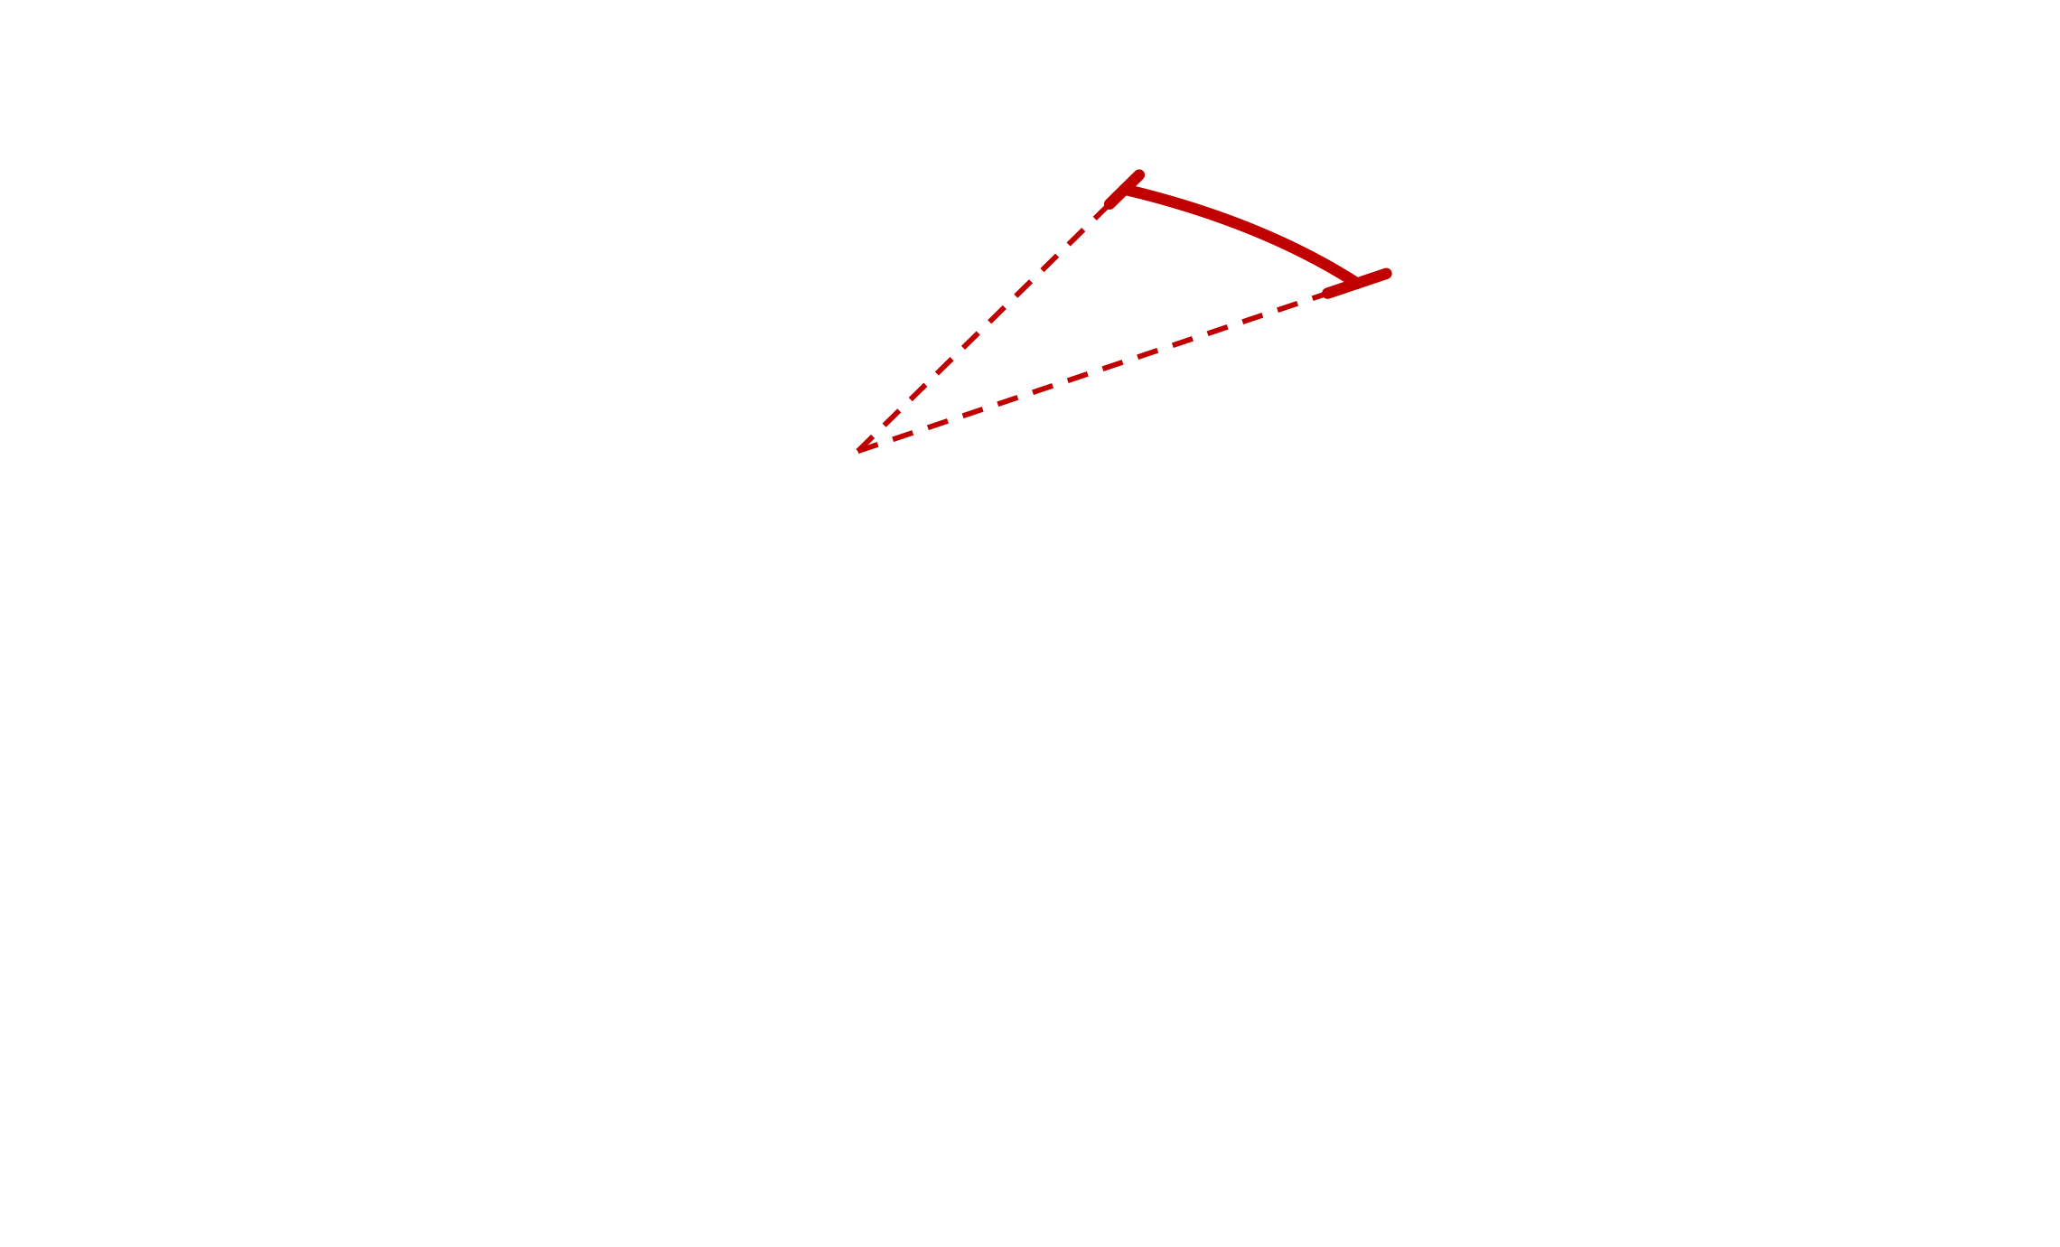
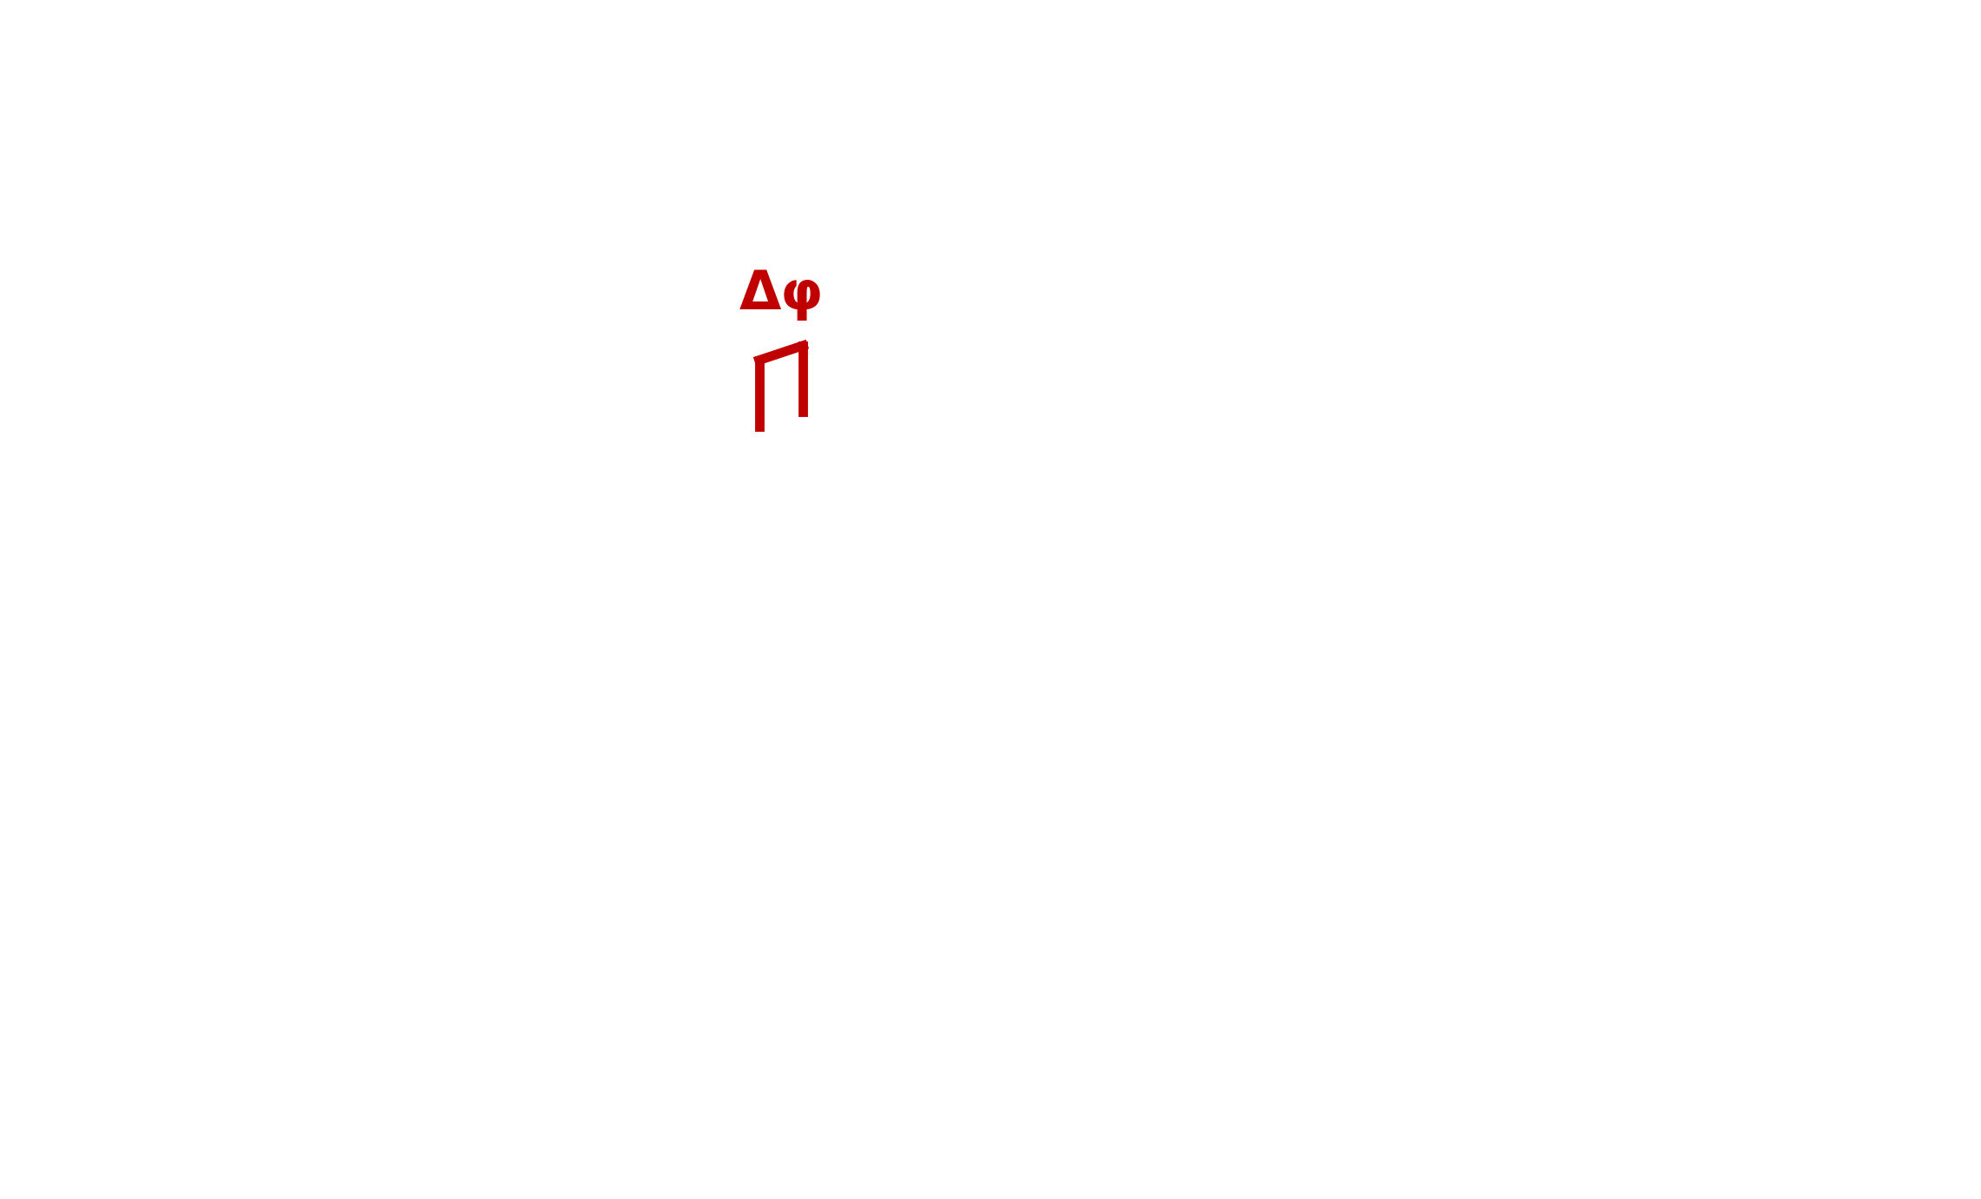
Key idea: use hardware limitations as inductive biases, not as noise
Restrict what the field may represent to what the antenna array can actually observe
array geometry → cone shape
a line of 4 antennas: no elevation resolution, front and back look alike, so the cone is full-height with a mirror twin
finite angular resolution → cone width
the cone spans the directions the array cannot resolve (previous slide)
unstable phase → relative-phase loss
only phase differences between antennas are trusted, in the loss and in the output
12 such cones around the receiver: the field is only asked to explain what these can observe

Slide 9
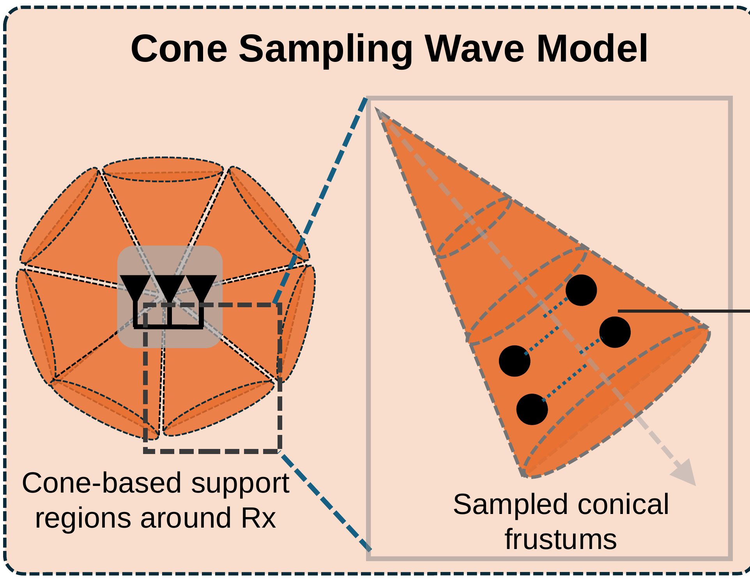
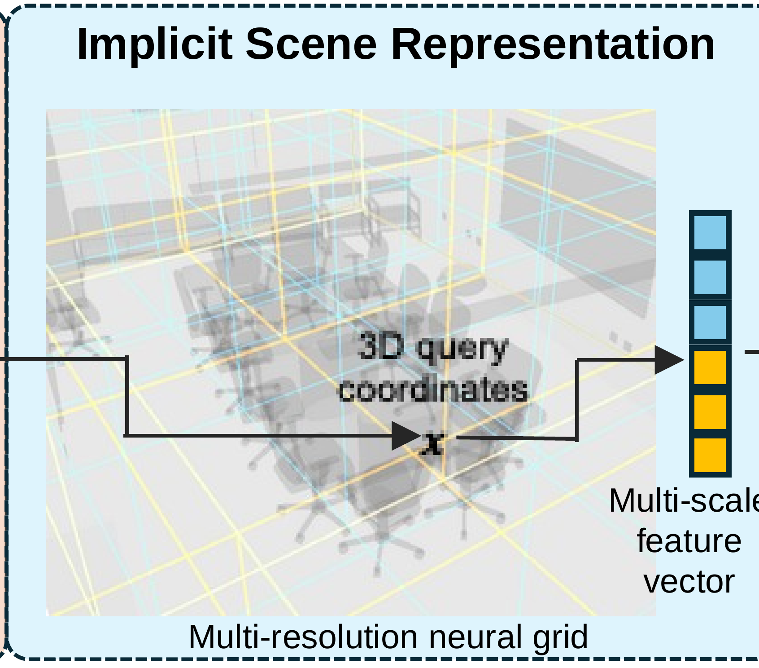
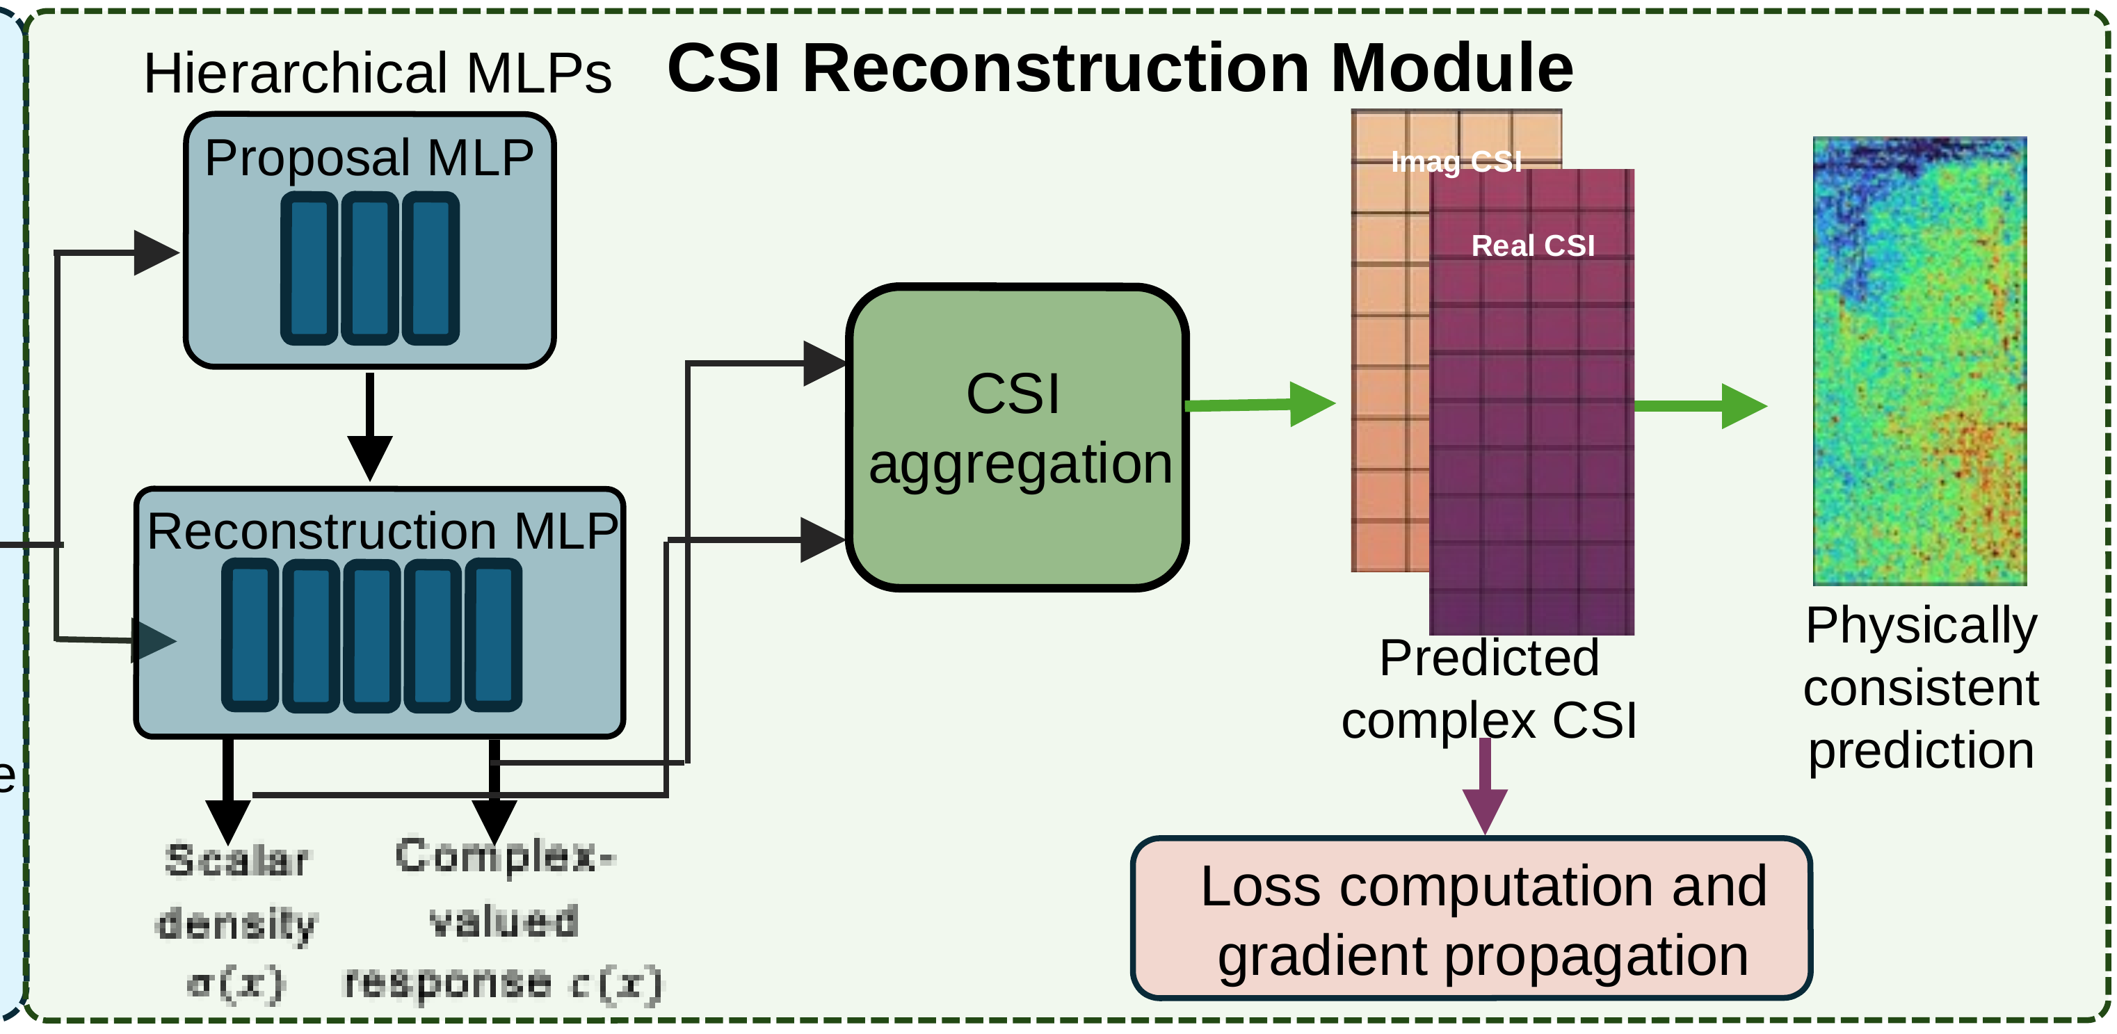

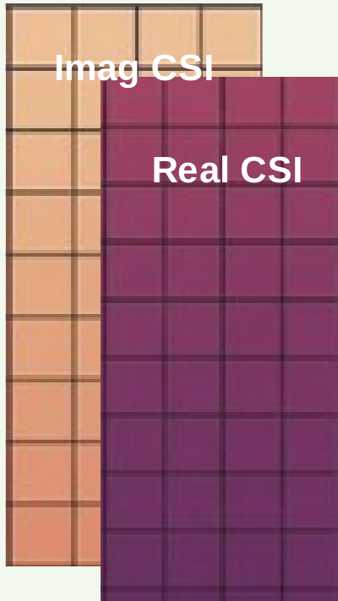
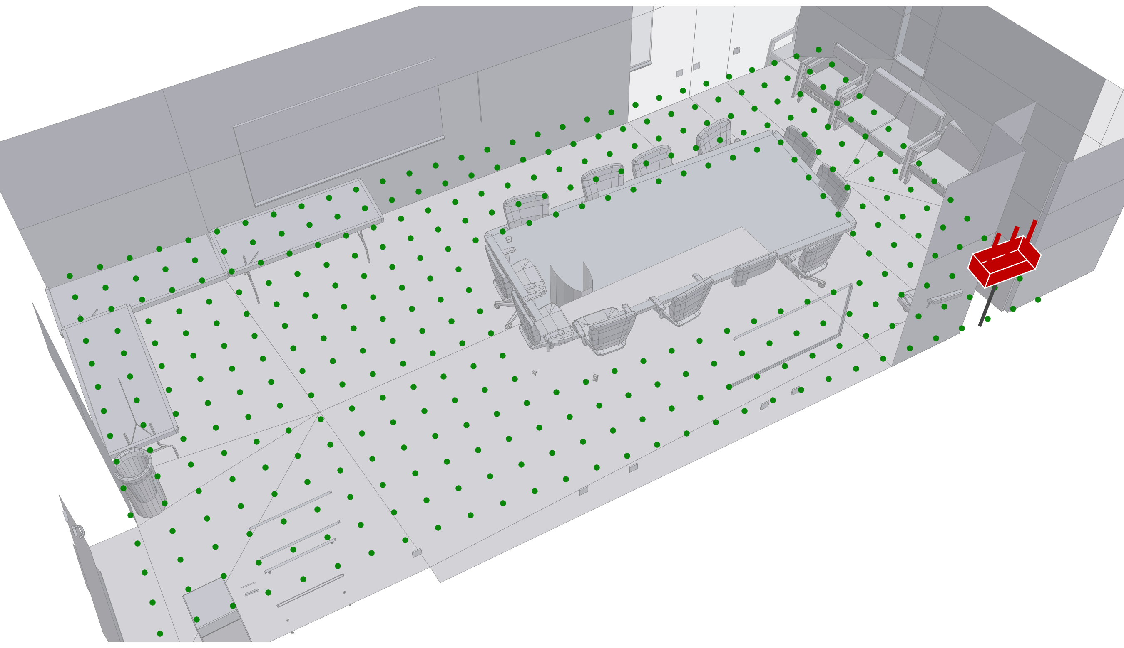
WiNeRF: from sparse CSI to a continuous complex-valued channel field
three measurement-driven modules turn sparse CSI into a queryable channel field
cone sampling
answers: finite angular resolution
one sample volume per resolvable sector
multi-scale scene
answers: reflectors at all scales
hash grid, room to furniture scale
CSI reconstruction
answers: unstable absolute phase
renders the 4×50 complex CSI; trained with a relative-phase loss
Input
sparse CSI at the measured positions
differentiable rendering
Output
complex CSI at any location
loss gradients flow back through all modules

Slide 10
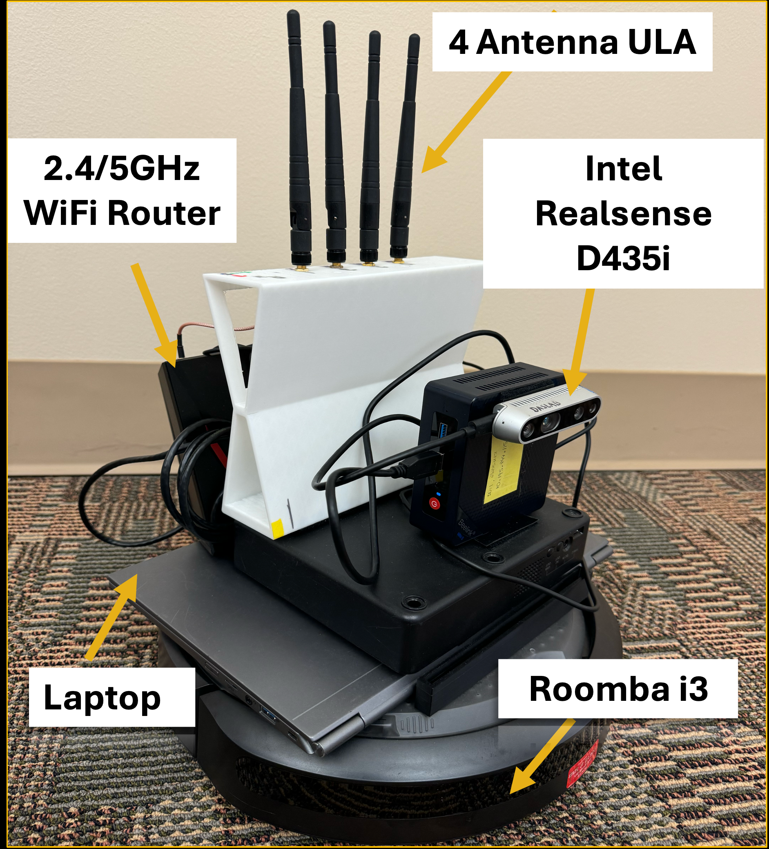
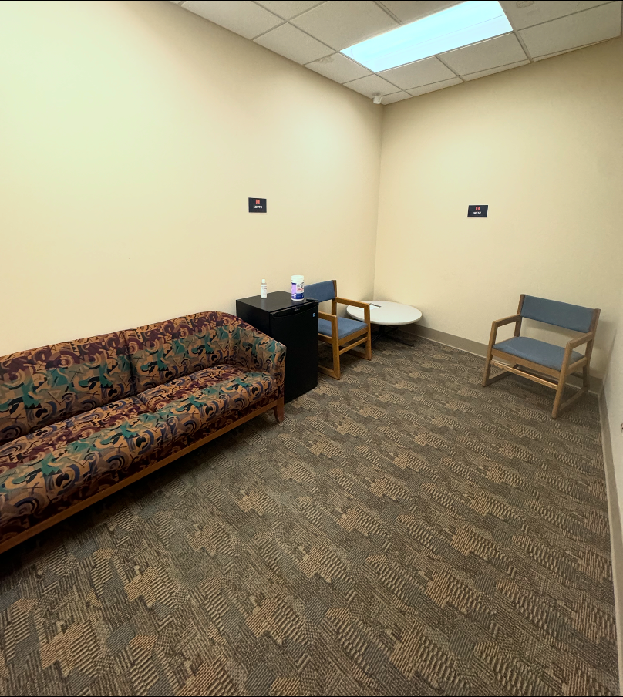
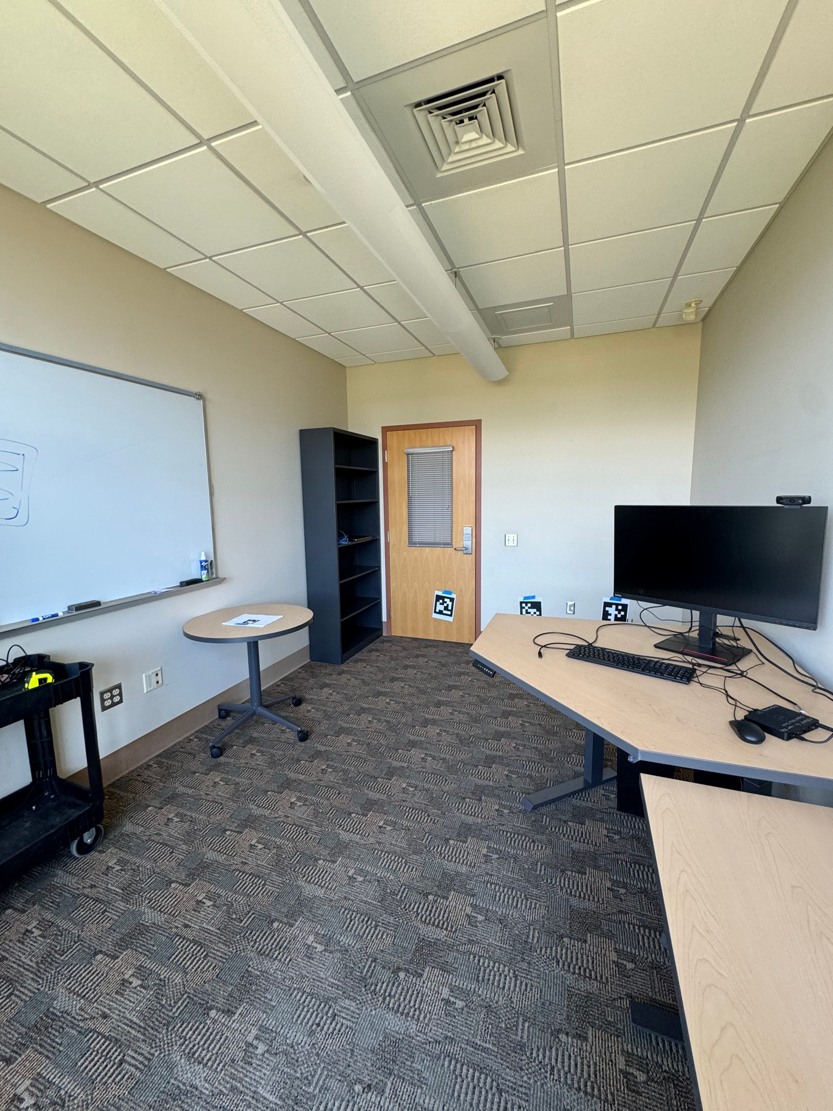
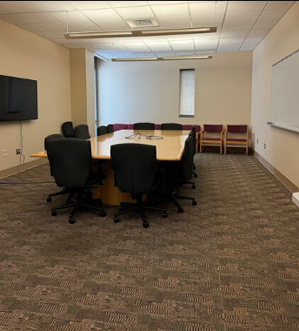
Evaluation: Commodity-WiFi CSI collected from a robot in three rooms
Meditation Room
4 × 2.25 m, small and cluttered
Office Space
5 × 3 m, metal cabinets
Conference Room
12 × 6 m, table blocks line of sight
~30k synchronized CSI + pose samples
≈ 4 per ft³ (NeRF² needs ~178)
the measurement platform
LoS and NLoS conditions in every room
5-fold cross-validation at held-out receiver positions
off-the-shelf parts: ASUS router on a custom 4-antenna mount; depth camera for pose (SLAM)
measurement positions along random trajectories (illustrative)

Slide 11
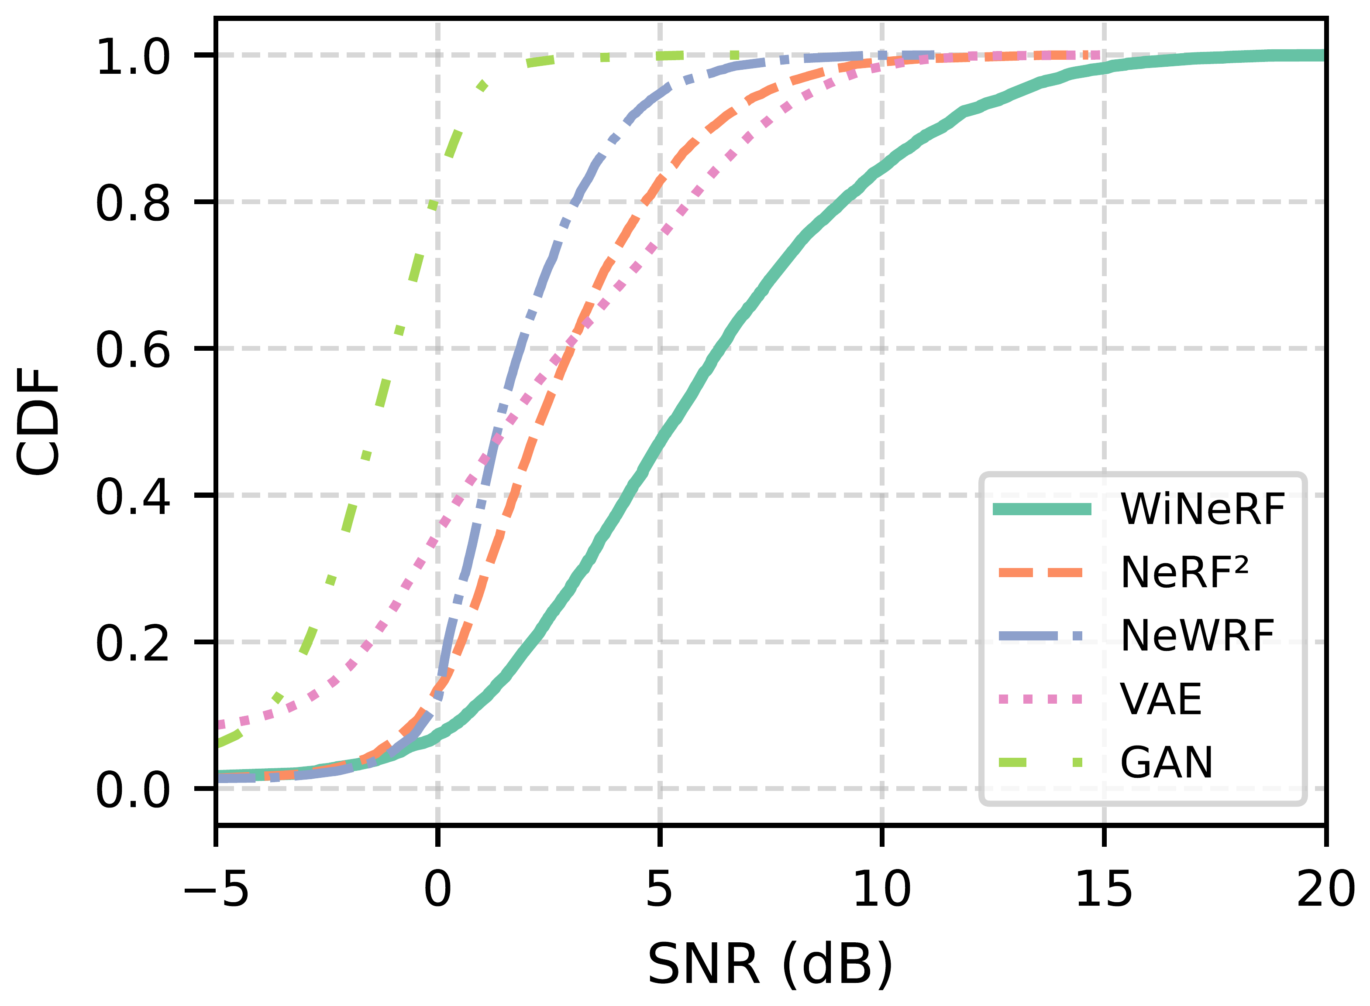
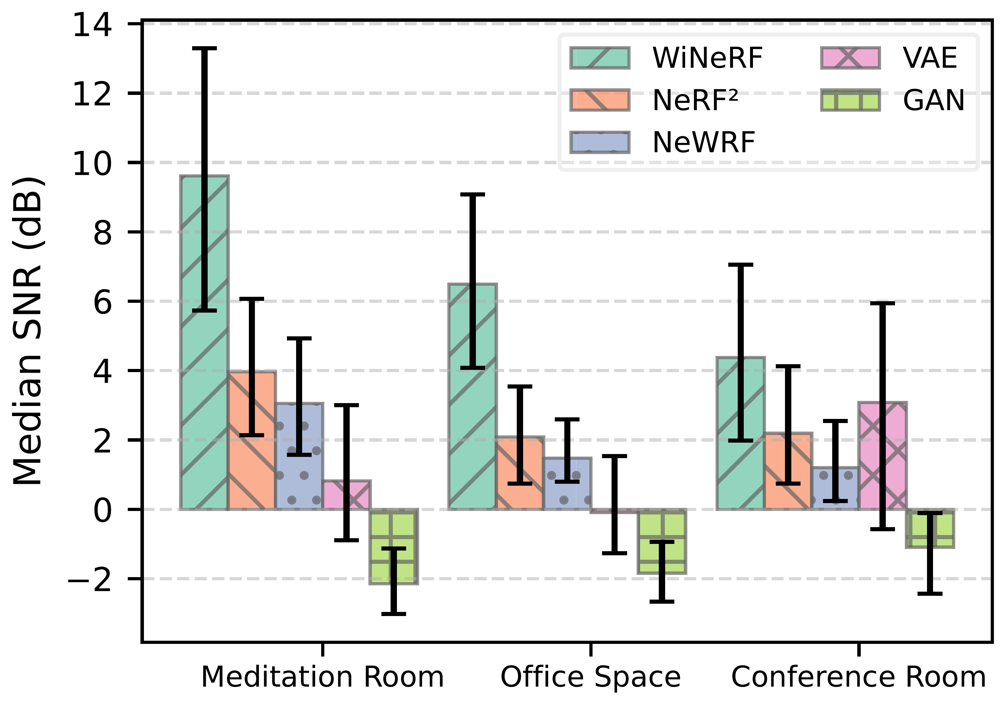
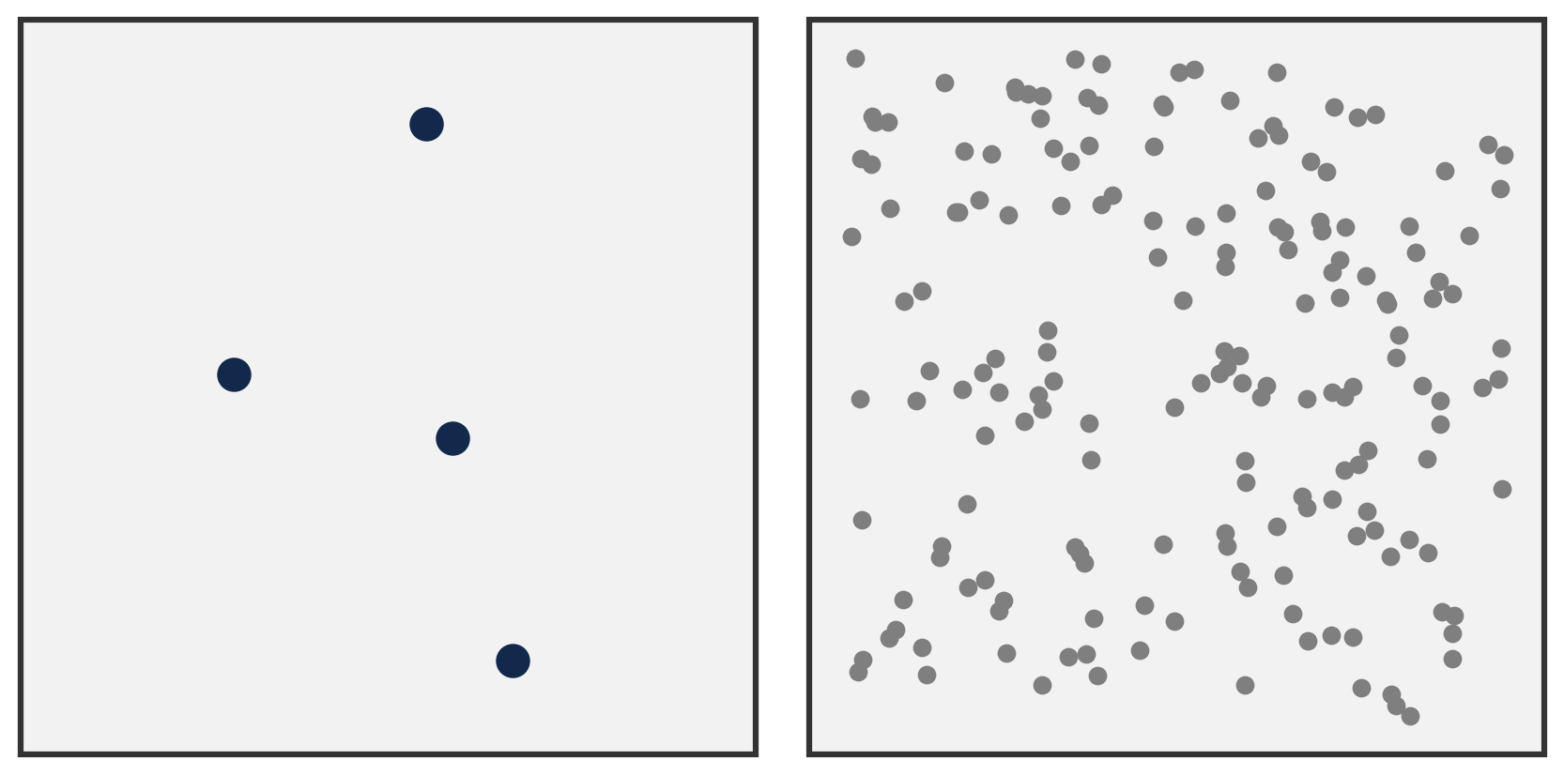
WiNeRF predicts complex CSI ~3× more accurately than prior neural baselines
prediction SNR, all environments (higher is better)
median SNR per room
5.3 dB
median prediction SNR
+4.9 dB
vs. baselines on average (≈ 3×)
4 vs 178
samples / ft³: ours vs. NeRF²

Slide 12
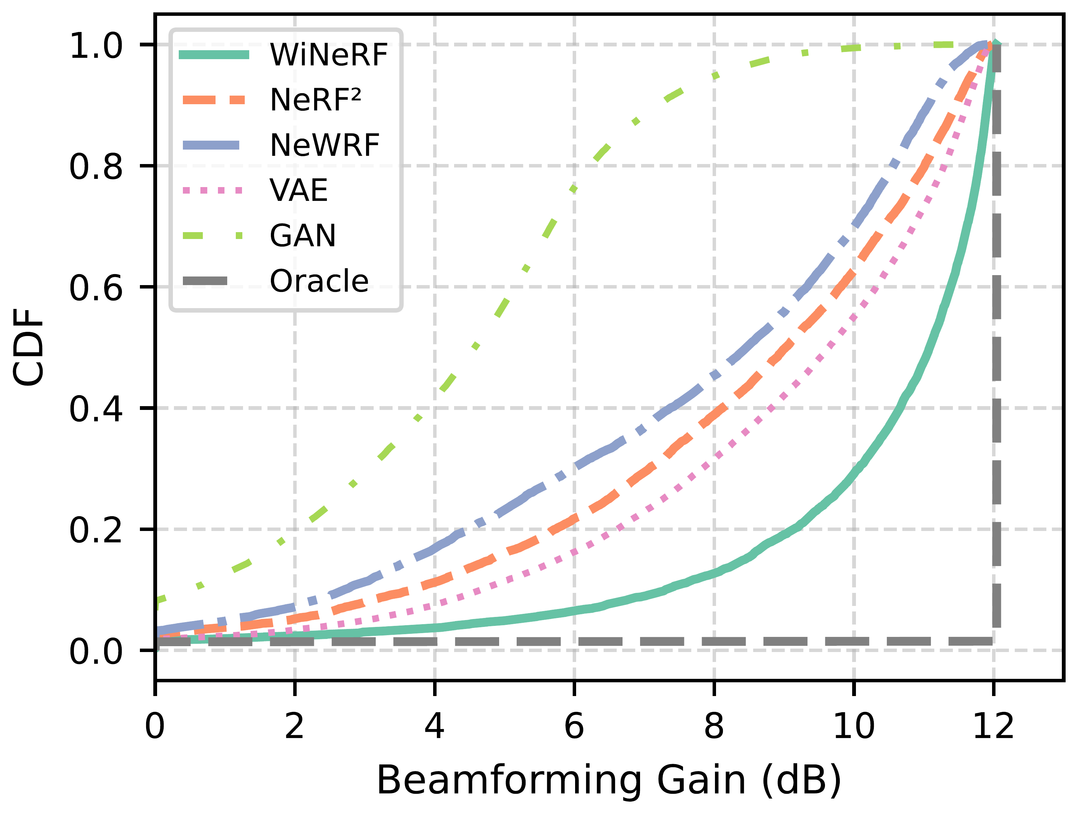
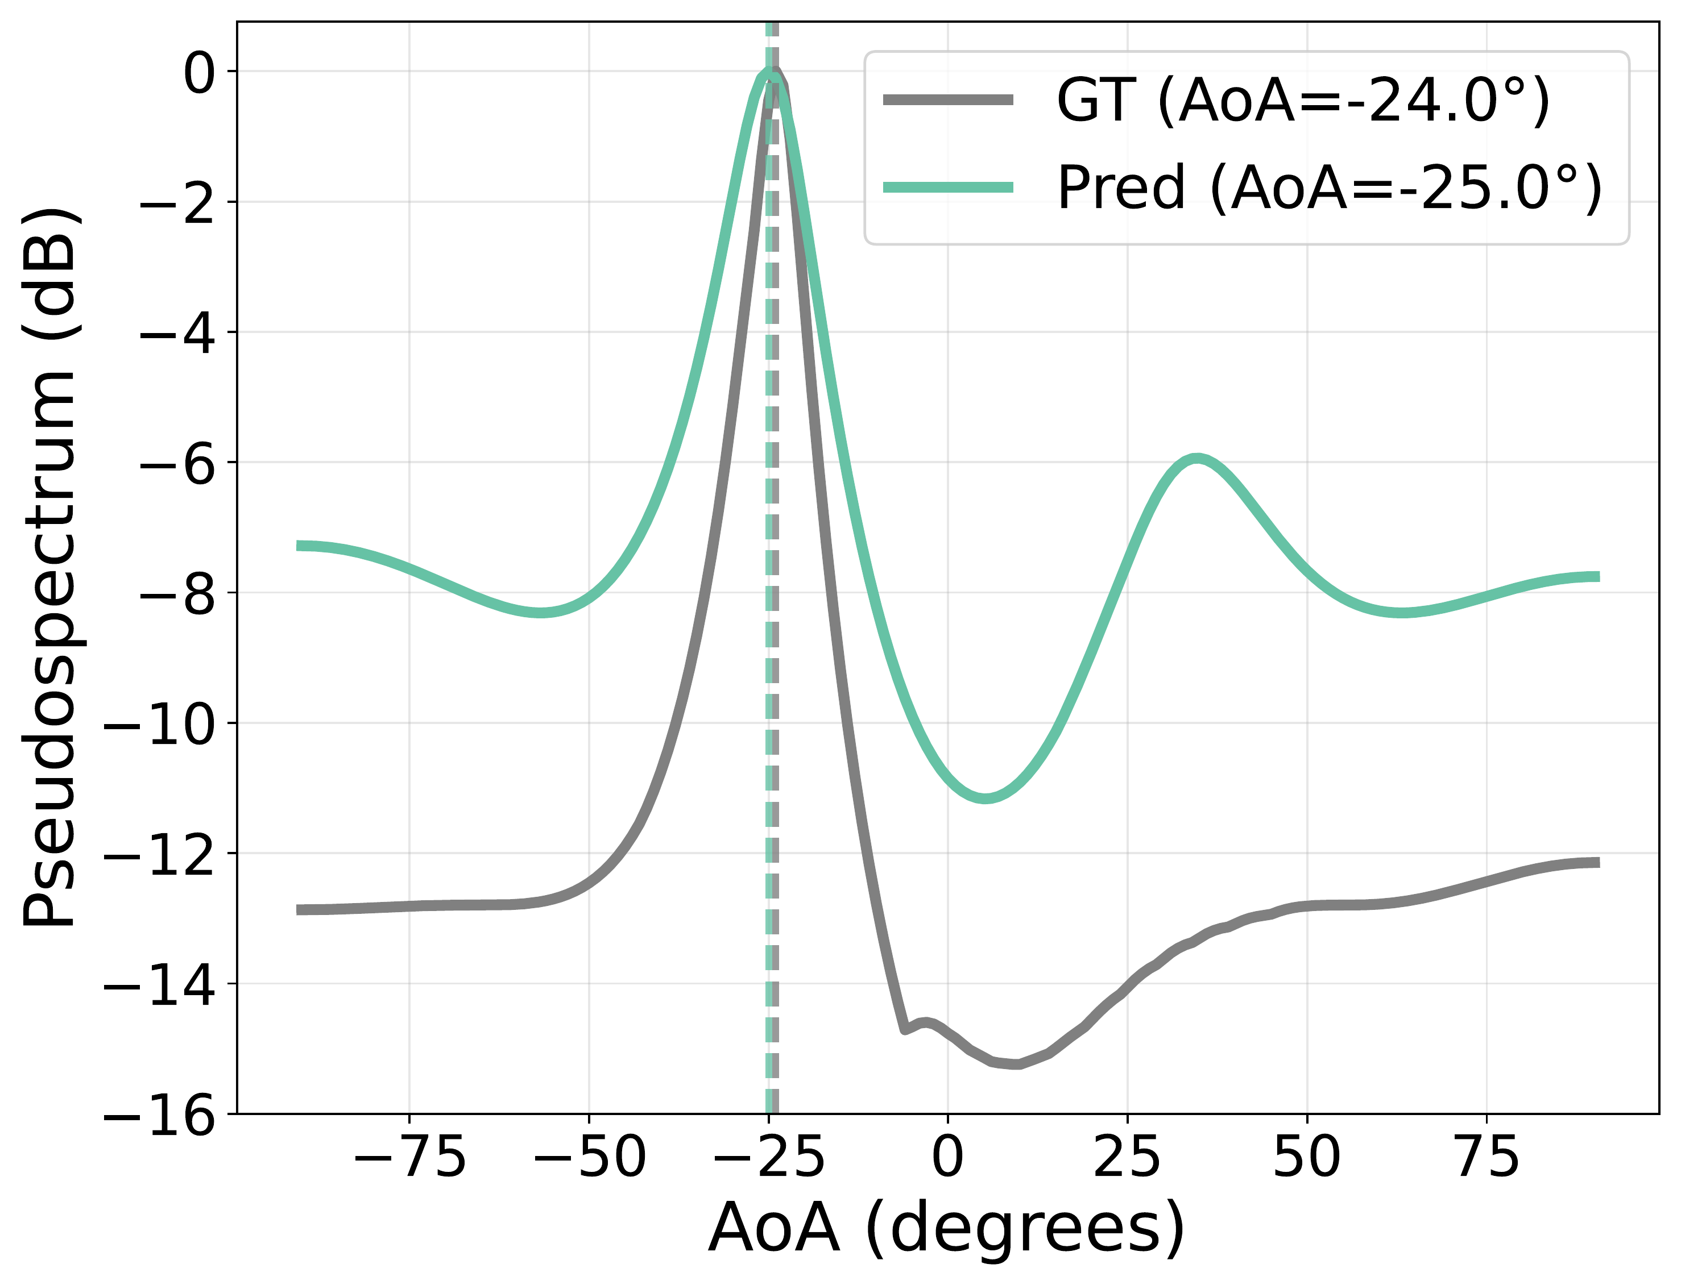
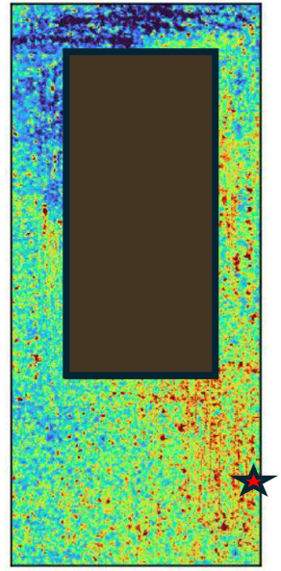
Accurate CSI is not enough: it has to be directly usable
standard signal-processing algorithms consume WiNeRF’s complex CSI as-is
predicted complex CSI
4 × 50, at any location
equal-gain combining
beamforming gain
MUSIC
line-of-sight AoA
|H|² averaged over antennas and subcarriers
RSSI coverage map
no downstream model is trained: the algorithms are unchanged, WiNeRF estimates the CSI input

Slide 13
Phase is preserved: near-oracle beamforming and accurate LoS AoA
beamforming gain with equal-gain combining (CDF)
MUSIC pseudospectrum, measured vs. predicted CSI
11.4 dB median gain vs. 12 dB oracle
~3 dB over baselines ≈ 19% more link capacity
13° median LoS AoA error
≈ 23 cm at 1 m; multipath peaks line up too

Slide 14
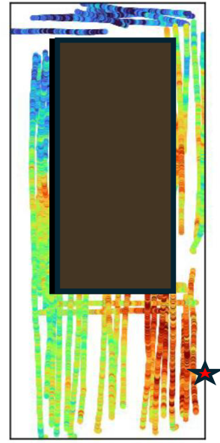
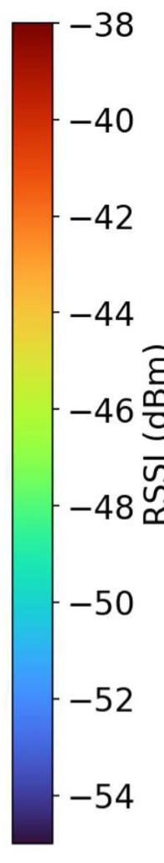
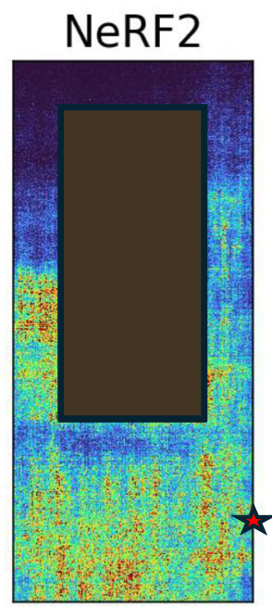
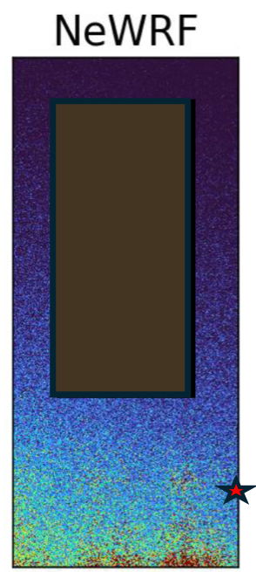
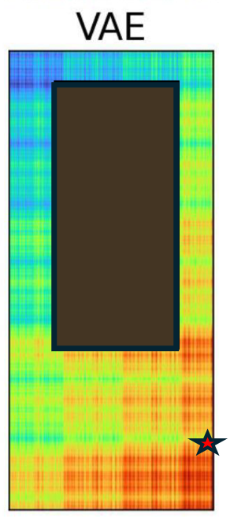
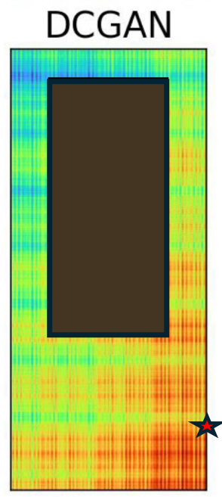
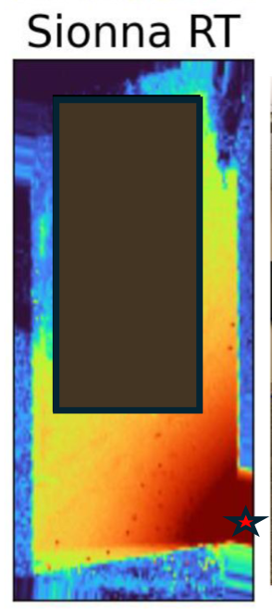

Sparse measurements become a dense, room-scale coverage map
measured (sparse)
WiNeRF prediction
baselines, same room
2
3
learned baselines + Sionna RT (ray tracing with a 3D CAD model)
1 LoS hotspot around the transmitter
1
2 NLoS shadow on the far side of the table
3 even ray tracing from a 3D model gets the table region wrong
the model has no detail close to the table

Slide 15
Takeaways
Measurement constrained
hardware limits become inductive biases
Sparse → continuous
complex CSI at unseen locations from sparse real measurements (5.3 dB, ≈3× baselines)
Actionable
beamforming, AoA and coverage maps straight from the predicted CSI
Thank you! Questions?

Slide 16
References
[1] A. Muralidharan and Y. Mostofi, “Communication-aware robotics: exploiting motion for communication,” Annual Review of Control, Robotics, and Autonomous Systems, 2021.
[2] D. Romero and S.-J. Kim, “Radio map estimation: a data-driven approach to spectrum cartography,” IEEE Signal Processing Magazine, 2022.
[3] A. Alkhateeb, S. Jiang, and G. Charan, “Real-time digital twins: vision and research directions for 6G and beyond,” IEEE Communications Magazine, 2023.
[4] X. Zhao, Z. An, Q. Pan, and L. Yang, “NeRF²: neural radio-frequency radiance fields,” ACM MobiCom, 2023.
[5] T. Orekondy et al., “WiNeRT: towards neural ray tracing for wireless channel modelling and differentiable simulations,” ICLR, 2023.
[6] X. Chen, Z. Feng, K. Sun, K. Qian, and X. Zhang, “RFCanvas: modeling RF channel by fusing visual priors and few-shot RF measurements,” ACM SenSys, 2024.
[7] H. Lu, C. Vattheuer, B. Mirzasoleiman, and O. Abari, “A deep learning framework for wireless radiation field reconstruction and channel prediction” (NeWRF), arXiv:2403.03241, 2024.
[8] H. L. Van Trees, Optimum Array Processing, Wiley, 2002.
[9] A. Goldsmith, Wireless Communications, Cambridge University Press, 2005.

